Slide 1
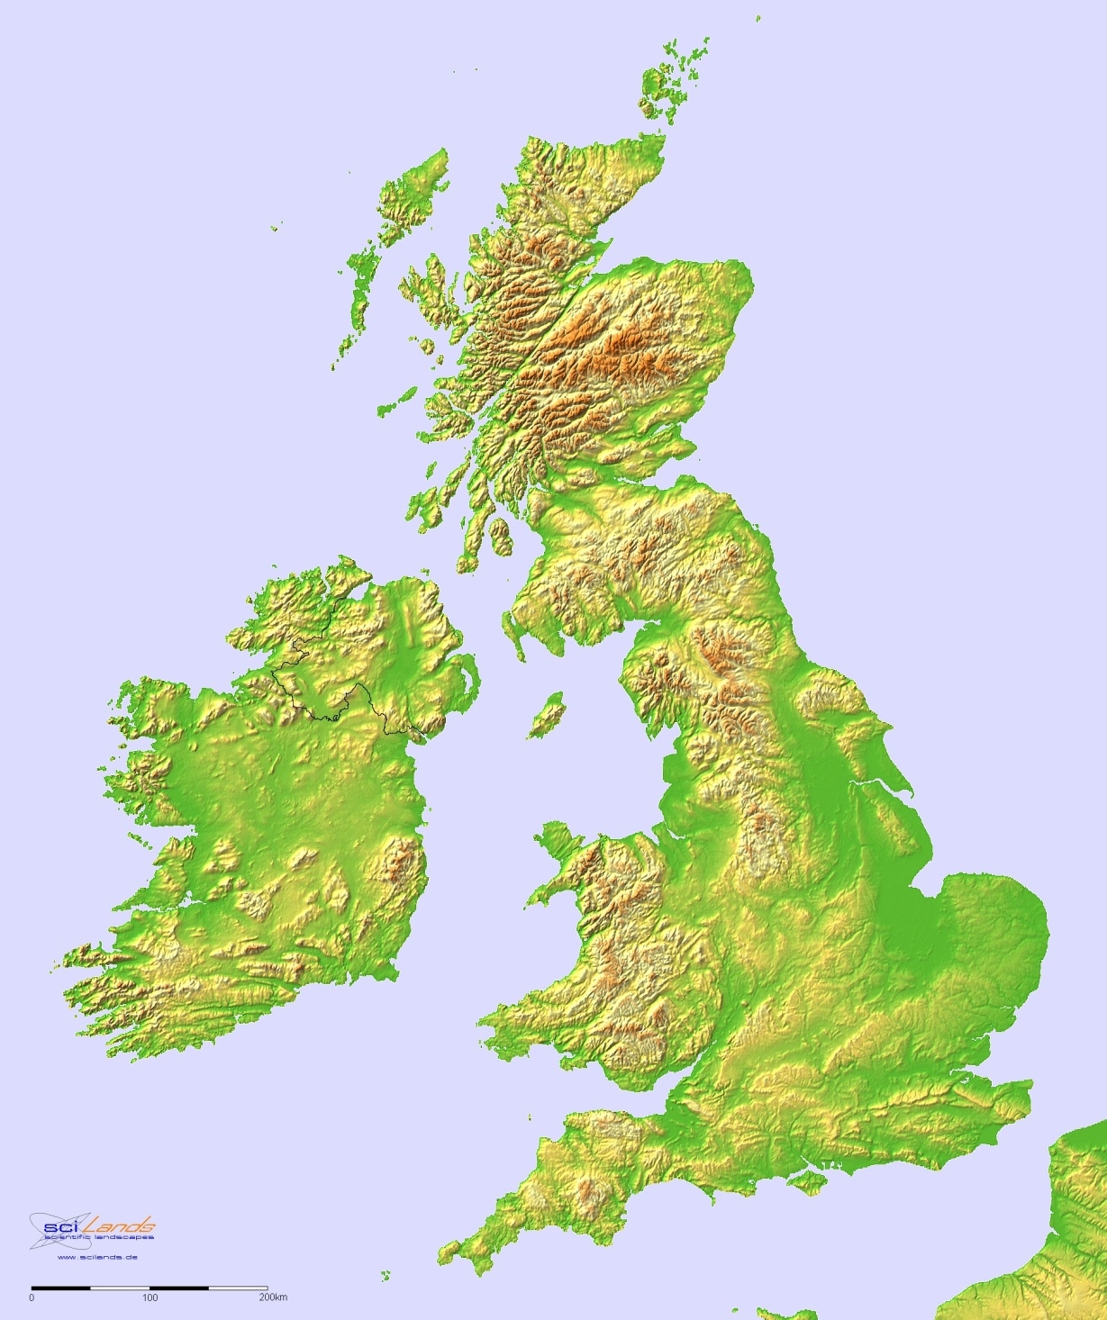
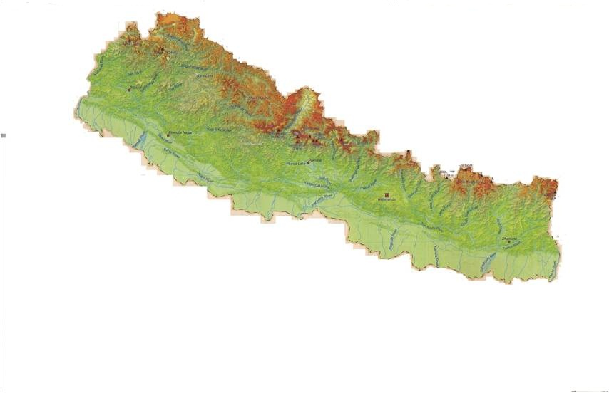
THE LIMITS OF NATIONALISM: POLITICAL IDENTITY IN NEPAL AND THE BRITISH ISLES John Whelpton BNAC Lecture, 23/3/16

Slide 2
ROOTS OF NATIONALISM
"A Nation... is a group of persons united by a common error about their ancestry and a common dislike of their neighbors“ (Karl Deutsch)
“I against my brother, my brother and I against the clan, our clan against the others, the clans together against the world” (Old Somali proverb)
“All the world’s queer save only thee and me, and even thou’s a bit odd.” (Old Yorkshire proverb)

Slide 3
Dispersal of modern humans from Africa

Slide 4
SINO-TIBETAN LANGUAGES

Slide 5
The `Kurgan model’ of the dispersal of Indo-European languages from Ukrainian/Russian steppes, c.4,000 - 1000 B.C.?

Slide 6
THE ETHNIC MIX (percentages are not authoritative!)
`JANAJATIS’ (TIBETO-BURMANS, MONGOLS) – mostly originally speakers of Tibeto-Burman languages and animists or Buddhists but now often assimilated into Hinduism and speaking Nepali or another Indic language 36%
PARBATIYAS (INDO-NEPALESE, KHASAS) – original speakers of NEPALI (aka Parbatiya, Khas Kura, Gorkhali), normally Hindu. Divided into castes. 38%
MADHESIS – sharing the culture and caste structure of the north Indian plain. Speaking various Indic dialects but often using Hindi as a lingua franca. 17%

Slide 8
WHO CAME FIRST?
Kusunda? Raute? Tharu? Satar (Munda)? Kurukh (Dravidian)?
Main janajati groups (?2nd millennium B.C onwards? But some groups arrived much later – e.g.the Sherpas’ arrival can be dated precisely to 1533 A.D.)
Parbatiyas (? Early first millennium A.D. onwards; reinforcement by migration from plains – Rajputs, some dalits)
Madhesis (Major settlement wave at end of the 18th century (?) but some earlier presence; reinforcement by later migration from south)

Slide 9
FLUID BOUNDARIES
Groups sharing a single ethnonym were often composed originally of diverse elements.
Construction of the Kshatriya/Chhetri caste by marriage between high caste Hindu and lower caste or `tribal’ or simple conferment of caste status:
`Khus and Mungur tribes of the Chetree class’ (Kirkpatrick)
Similar creation of Brahmans?

Slide 10
PEOPLING OF THE BRITISH ISLES
Repopulation at the end of the last Ice Age (c.14,000 years ago) by settlers who probably account for most of the ancestry of present-day inhabitants
Celtic (a branch of Indo-European) becomes dominant (1st millennium B.C.), probably through earlier population adopting language of incomers
Roman occupation 43-410 A..D – relatively little genetic impact
Germanic (Anglo-Saxon) invasion of Britain (not Ireland) from 5th century A,D. onwards – substantial settlement in Eastern England, expansion more by assimilation of natives than repalcement in Western England. Development in England and southern Scotland of English from Germanic dialects, which are Indo-European but very different from Celtic .
Scandinavian (Viking /Norse/Danish) settlement in 9th century – assimilated later into Anglo-Saxon society.
Norman Conquest 1066 – imposition of a small French speaking elite which is eventually assimilated into English society but with the English language under strong French/Latin influence.
Ireland, the Scottish Highlands, Wales and Cornwall remain Celtic-speaking throughout the Middle Ages. In Scotland Brythonic Celtic replaced in the Highlands by Gaelic (Irish Celtic) and in the Lowlands by Scots (a dialect of English)

Slide 11
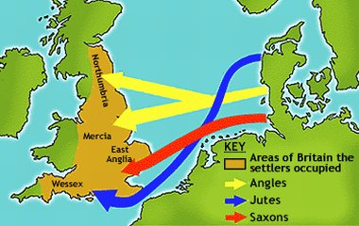
Germanic migration into Britain in the 5th. Century A.D.

Slide 12
STATE AND NATION IN THE BRITISH ISLES – TIMELINE
4th-6th cent. Anglo-Saxon settlement
878 Alfred defeats the Danes at Edington
9th cent. Union of Scottish and Pictish thrones
10th.cent. Conquest of the Danelaw
1066 Norman Conquest
1282-3 English conquest of Wales
1314 Battle of Bannockburn secures Scottish independence
1320 Declaration of Arbroath
1603 Union of English and Scottish thrones – unofficial use of
the name `Great Britain’
1707 Act of Union between England and Scotland
1801 Act of Union between Great Britain and Ireland
1920 Partition of Ireland
1922 Recognition of independence of the Irish Free State, nominally under British Crown
1948 Irish Free State formally declares itself a republic
1998 Establishment of Welsh Assembly
1999 Establishment of Northern Ireland Executive and of Scottish Parliament

Slide 13
PARALLELS (I): LANGUAGE and POPULATION INTERFACES
A rough analogy between the dominance of the Germanic English and Indo-Aryan Nepali languages and their speakers over Celtic and Tibeto-Burman languages and people respectively.
Both Britain and Nepal derive their names from the `subaltern’ language group: `Britain’ (Welsh Prydain) probably derives from Welsh pryd (`shape, form), while `Nepal’ most plausibly is composed of the Tibeto-Burman roots nhet (`herd’) and pa (`man’)
The linguistic divides do not strictly correspond to genetic ones: English-speakers in the British isles are probably mostly descended from Celtic speakers, Parbatiyas less of a continuation of earlier population but considerable mixing. Elite intermingling suggested by the Magar names in the Shah genealogy and the Celtic ones in that of royal house of Wessex.
Evidence for strong hostility at times - e.g. the discrimination against weala (`foreigner, Welshman’) in Anglo-Saxon law, the population flight from Jumla and the eastern hills.
State role in fostering assimilation: most obvious in modern times (e.g. punishment of 19th century pupils for speaking Welsh, the Panchayat language policy) but also earlier – the incentive to escape weala staus in 7th century, Scottish parliament’s legislation against the `Irish language’ in the 16th century, belief by some Magars that ancestors told by a chaubisi ruler to switch to Nepali (Hamilton at the beginning of the 19th century saw Parbatiya as `rapidly extinguishing the aboriginal dialects of the mountains’)

Slide 14
PARALLELS (II): EARLY ENGLAND AND NEPAL
10th century England and 18th century Nepal – unification or mere conquest?
Both the House of Wessex and the House of Gorkha relied on military force to bring northern England (ruled then by the Norsemen as `the Danelaw’) and the eastern Himalayas under their respective control.
Both could rely on some pre-existing similarities:
Close relation between the Anglo-Saxon dialects , prior acceptance of either `Angle’ or `Saxon’ (Welsh `Saes’, Scottish Gaelic `Sassenach’) as a common label (Danish settlers initially excluded but their own language was also Germanic); Alfred’s possible coining of Angelcynn; notion of ecclesia anglicana and gens anglicana
In western hills, similarity of Parbatiya dialects ; in hills generally, a common sense of Pahadi identity vis-s-vis the plains; broadly similar form of Hinduism
Both Pritihvi Narayan and the kings of Wessex project themselves as champions of their own religion, Alfred also as a patron of learning
But in Nepal (especially in east) social divisions starker then in England where Celts by now largely integrated into Anglo-Saxon society.
Claim of defence against an alien threat more important for the English case where Danish conquest was being reversed. The threat of the East India Company not initially important for PNS.

Slide 15
PARALLELS (III): EARLY SCOTLAND AND NEPAL
The merger of originally very distinct groups
The Highlands/Lowlands and Pahad/Madhes opposition – but in Scotland it is the Lowlands, culturally similar to England, which are dominant.
The Gaelic/Scots and Tibeto-Burman/Indo-Aryan linguistic contrasts
Early notions of limits to royal power – but in the Scottish case proto-nationalism (with caveats!)rather than dynastic loyalty is to the fore
Defining themselves against their neighbour (England, (Ma)dhes/India) and making tactical use against it of another, less culturally similar neighbour (France, China)

Slide 16
THE PEOPLES OF SCOTLAND
The Picts (probably Celtic but distinct from the main British Celtic population)
The `Strathclyde Welsh’ (culturally similar to Britons in the south of the island – later assimilated into other groups))
The Gaels (`Q-Celtic’ incomers from Ireland, become dominant in the islands and Highlands; traditionally supposed to have provided the first king of a united Scotland in the 9th century but Kenneth MacAlpin may also have had Pictish ancestors )
Germanic settlers in the South-East (culturally dominant)

Slide 17
THE POWER OF THE KING’S COUNCIL
...if this prince shall leave these principles and consent that we or our kingdom be subjected to the king and people of England .we will make another king who will defend our liberties. For so long as there shall but one hundred of us remain alive we will never agree to submit ourselves to the dominion of the English. For it is not glory, it is not riches, neither is it honours, but it is liberty alone that we fight and contend for, which no honest man will lose but with his life.‘ Declaration of Arbroath, 1320
The leading members of this body, whether actually employed or not, appear to possess such a high authority in the state, as renders it nearly impossible for the executive government, in whatever hands that might be, to pursue any measures of an important nature, in opposition to their advice. I have even been assured that the throne of the prince himself would no longer be secure should the principal thurghurs [an older term for the principal bharadars] concur in thinking that his general conduct tended to endanger the sovereignty, which they [consider] them­selves bound, as far as rests with them, to transmit unimpaired to the distant posterity of its founder.
Kirkpatrick on the role of the bharadari as explained to him in 1793

Slide 18
THE PARALLEL BREAKS DOWN - MERGER WITH ENGLAND
Pre-union relationship similar to that between the Newar kingdoms of the Kathmandu Valley – both hostility and close kinship. The Scottish and English kings who fought the Battle of Flodden (1513) were brothers-in-law
Union of thrones (1603) precedes union of countries (1707)
The dominance of the Lowlands reinforced with the failure of the 1745 Jacobite rebellion which drew heavily on Highlands support.
A strong sense of Scottish identity, adopting cultural symbols of the marginalised highlands (kilt, bagpipes etc.), co-existed with one of British identity through the 18th – 20th centuries.
Counter-factual Himalayan parallel: a Madhes-dominated Nepal is absorbed into India but the Madhesis themselves proudly wear the topi to preserve a distinct identity from their southern neighbours.

Slide 19
PARALLELS (IV): USES OF THE PAST
The Cults of King Alfred and of King Prithvinarayan Shah
Myths of descent

Slide 20
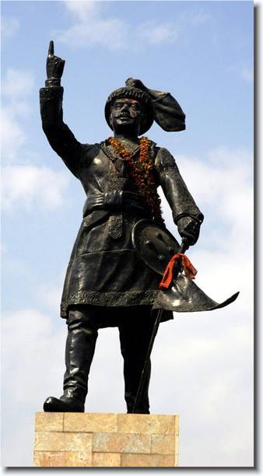
Prithvinarayan Shah of Gorkha Alfred of Wessex

Slide 21
ALFRED
The best-remembered Anglo-Saxon ruler – still enjoying a high reputation despite reaction against dynastic history
Promoted as a national icon after the Reformation in the 16th century when Protestant England needs to stress its continuity with the Anglo-Saxon church in contrast to a post-Norman conquest institution which was more heavily under papal control.
High point is the Victorian period: enthusiasm for England’s real or supposed Germanic roots and for muscular Christianity

Slide 22
PRITHVINARAYAN
A dominating figure till the mid-19th century – invoked in the deposition of King Rajendra in 1847
Darjeeling revival – Surya Bikram Gyawali’s biography – staking a Gorkhali claim for status in India?
Apotheosis under the restored Shah dynasty
Demotion after the end of the monarchy but now cross-party support for the restoration of Prithvijayanti (his birthday) as a national holiday.

Slide 23
PRESTIGIOUS ANCESTRY
Rajputs real or imagined – the Shah and Kunwar Rana claims.
Brutus the Trojan as a British ancestor.
The Teutonic forest and English freedom.
A narrative turned against the narrators by the discourse of indigeneity.

Slide 24
PARALLELS (V): IDENTITY ISSUES
NEPAL
BRITAIN
Caste/ethnic identity
Pahadi or Madhesi
Nepali citizen
South Asian (`Indian’ in the older sense)
Not part of `India’ in the modern sense but fearing absorption or domination
?? Religious/ethnic affiliation
English/Scottish/Welsh
British citizen
European
- Part of the European Union but often alienated

Slide 25
NEPAL AND INDIA: RIVAL NOSTALGIAS?
Lamenting the loss of Greater Nepal (Buddhinarayan Shrestha, `What is the Sugauli Treaty?’) and wishing for the break-up of modern India
Wishing the Nepalis would `behave like good, patriotic Indians’ (Leo Rose)

Slide 26
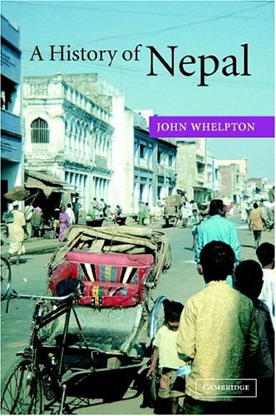
`[This picture] seems to have nothing to do … with Nepal – ancient, modern or in the making’ (K.P. Malla)

Slide 27
THE HRITHIK ROSHAN AFFAIR
`One of the most worrisome aspects of these violent days was that some Indians, including tourists…, Nepalis, especially from the Terai, who looked like Indians, and Marwaris were beaten up and their property damaged…Even the vendors who push bicycles laden with baskets of fresh fruit and vegetable from door to door in residential areas, and who are believed to be Biharis, were attacked and beaten, their bicycle tyres punctured and their produce ruined.’’ Elizabeth Hawley, The Nepal Scene, vol II – 1115-1116.
`Prior to the Hrithik Roshan scandal in December 2000, I used to consider myself a true Nepali. That incident turned me into a Madhesi. ‘
C.K. Raut, interviewed by Prashant Jha, Hindustan Times, Jan 2016

Slide 28
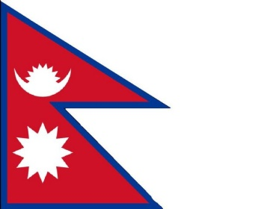
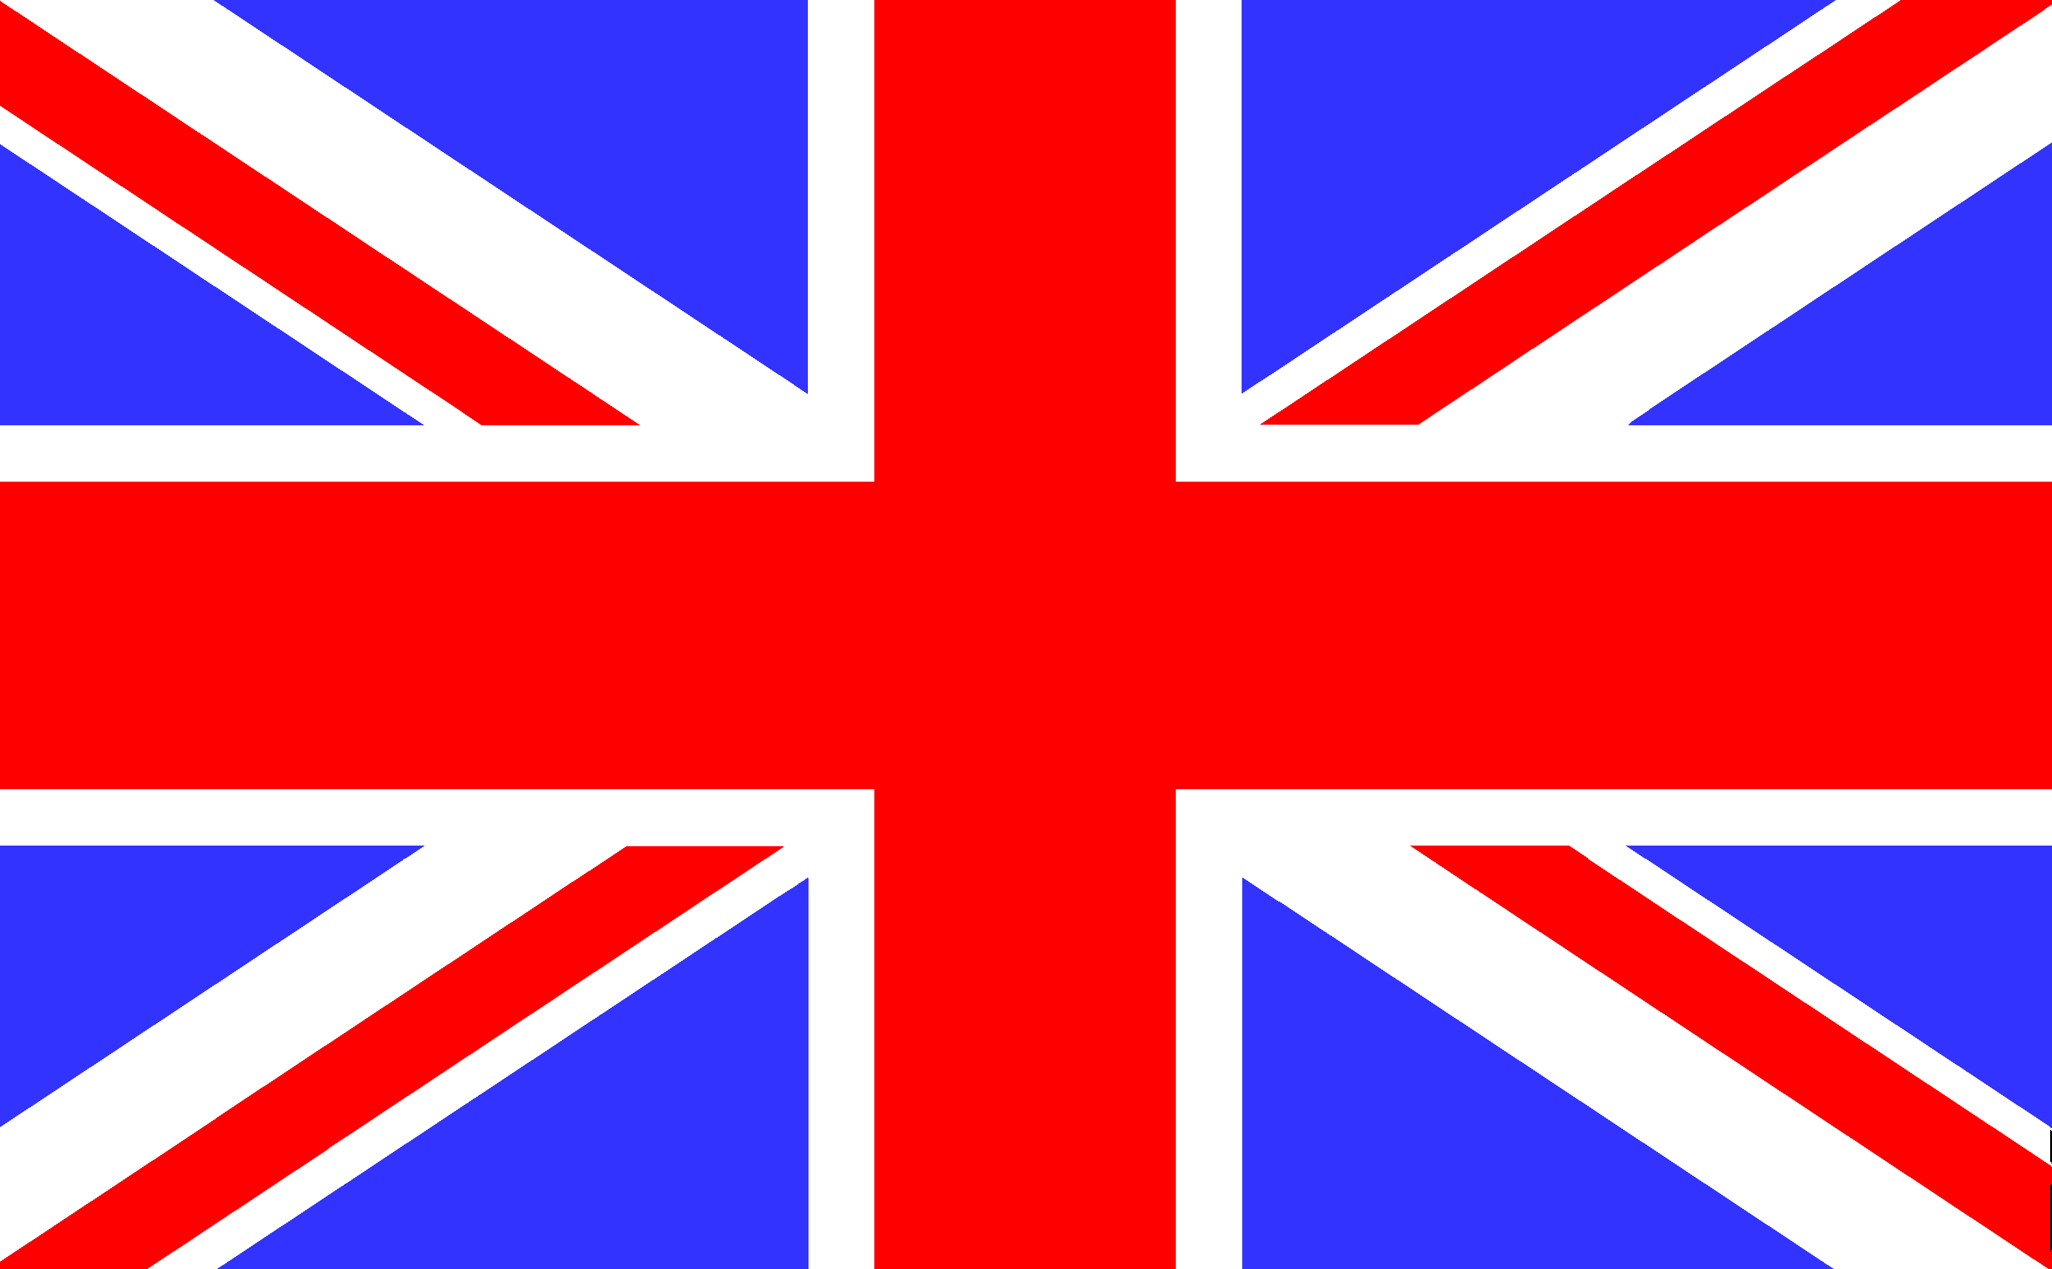
NEW IDENTITIES? (but keep both flags!)
Britain: replacing empire and Protestantism with shared language, Celtic roots and island status?
Nepal: replacing `Nepalipan’ (the hill cultural complex) with `Nepaliyata’ (an inclusive identity with new symbols (C.K. Lal, To Be a Nepalese) but stressing the Maithili contribution to the Kathmandu Valley’s cultural history (Abhi Subedi)rather than `heroes of the People’s War’
Boosting regional (European, South Asian) identities

Slide 29
THE MISSING EMOTIONAL DIMENSION
Semper regant in Europa fides et iustitia et libertas populorum in maiore patria. From the unofficial Latin lyrics written to accompany the EU’s officially adopted musical anthem (`Ode to Joy’ from Beethoven’s 9th symphony).
When they saw Indian people and the city of Bombay it felt as if they were back at home with their own families and they were very happy.
Jang Bahadurko Belait-Yatra, on the feelings of Jang and his companions when their ship reached India on return from Europe in 1850

Slide 30
MOVING IN THE WRONG DIRECTION?
The re-vitalisation of sub-Gorkhali ethnicity in Darjeeling: `We must become more tribal!’ (Shneidermann & Turin)
The increasing number of jat/jati associations in Nepal, the UK (Mitra Pariyar, ` Caste in Bone’) and Hong Kong

