Slide 1
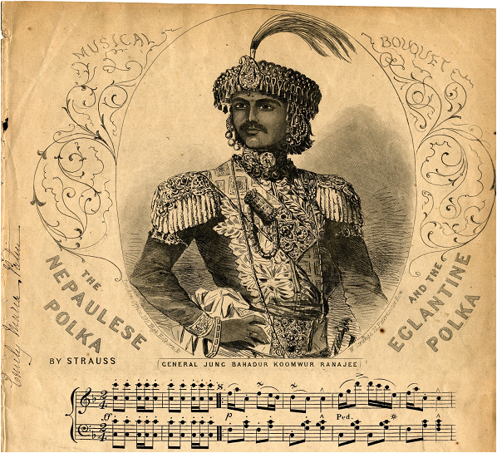
JANG BAHADUR IN EUROPE John Whelpton Social Science Baha, Kathmandu, 30/3/16

Slide 2
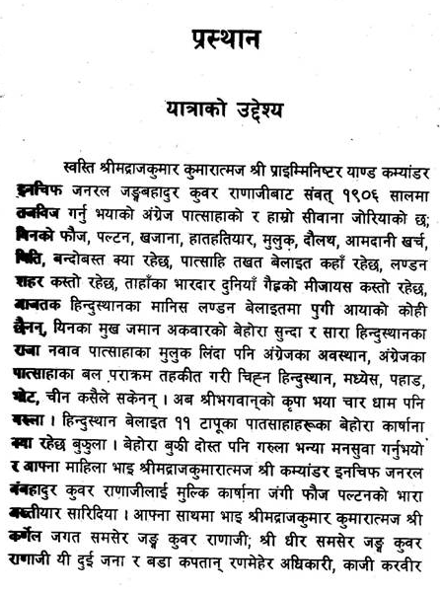
The opening of the Belait-Yatra in Kamal Mani Dixit’s edition (Kathmandu, Sajha Press, 1957/8)

Slide 3
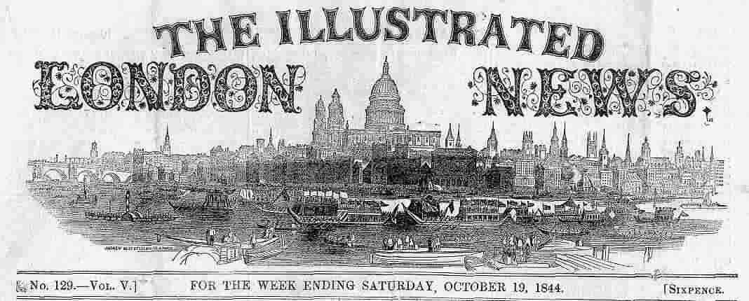
Masthead of the Illustrated London News, whose drawing of Jang Bahadur was widely copied in Britain and France

Slide 4
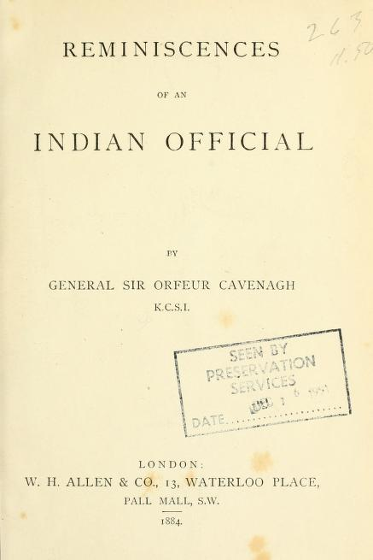
Memoirs of the British liaison officer who accompanied the embassy.

Slide 5
Letter in Jang’s own handwriting from London, instructing his brother how to deal with trouble-makers.

Slide 6
Moti Lal Singh’s July1850 New Monthly Magazine article, published in Nepali translation by Krishna Prasad Adhikai (2013)

Slide 8
Full details for ordering the book will be available next month on these sites
http://www.mandalabookpoint.com/upcoming.php?cat=Upcoming
http://linguae.weebly.com/nepali.html

Slide 9
Nepal and British possessions on the eve of the 1814-16 war

Slide 10
NEPAL, BRITAIN AND THE RANA REGIME
1768-69 Gorkha conquest of the Kathmandu Valley
1792 Chinese invasion of Nepal
1793 Kirkpatrick Mission to Kathmandu
1802-03 Captain Knox in Kathmandu
1809-10 Sikh ruler Ranjit Singh halts Gorkha expansion in the west
1814-16 War between the East India Company and the Gorkhas – formally ended by the ratification of the Treaty of Sugauli at Makwanpur on 4 March 1816
Jang Bahadur Rana becomes prime minister following the Kot Massacre
1850 Jang Bahadur’s visit to Britain and France
1856 Jang becomes Maharaja of Kaski and Lamjung
1857-58 Nepal assist’s the British in suppression of the `Indian Mutiny’
1877 Jang’s death
1885 Shamsher Ranas seize power
1951 Rana regime ended by alliance between King Tribhuvan, the Nepali Congress and India.

Slide 11
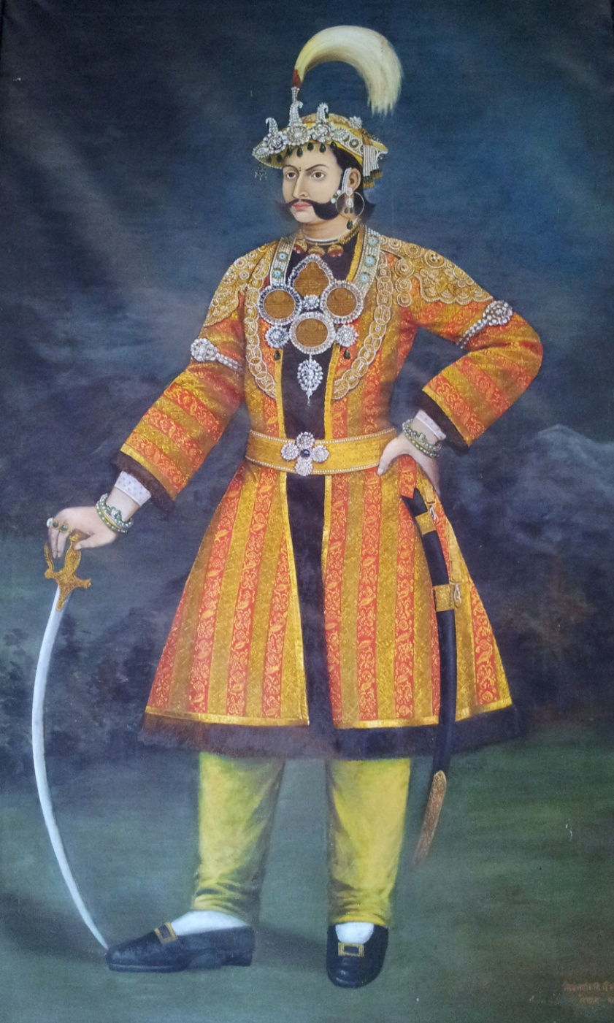
Bhimsen Thapa, mukhtiyar 1806-1837, and his nephew (and Jang’s uncle) Mahbar Singh, prime minister 1843-1845

Slide 12
Jang’s Objectives
Presented by the Belait-Yatra as a fact-finding and goodwill mission
The real agenda:
Conciliating the British now all of India was under their control?
Ensuring Jang’s personal position?
Concrete requests:
Extradition of absconding revenue collectors
Permission to employ British engineers
Right to by-pass the Resident and correspond directly with London

Slide 13
Portrait of Jang painted in 1905 V.S. (1848/9) by Bhajuman, the court artist who later accompanied him to Europe. (Reproduced by courtesy of Majarajkumar Mussories Shumshere J.B. Rana)

Slide 14
Portrait of Jang painted in London in 1850. Copies hang in both the South Asia Reading Room at the British Library and in the Keshar Mahal in Kathmandu

Slide 15
Jang Bahadur, Dhir Shamsher and Jagat Shamsher in London – unknown artist

Slide 16
Lord John Russell (eighth from the left ) and Lord Palmerston (seated in front of the map) in the Coalition Cabinet of 1854 (painting by G. Gilbert, reproduced by courtesy of the National Gallery)

Slide 17
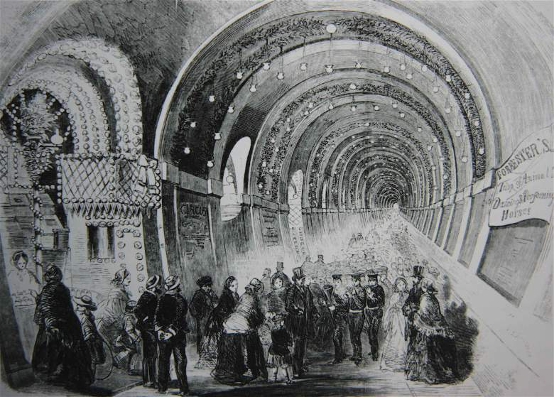
A Fair in the Thames Tunnel (1845) http://russiadock.blogspot.hk/2015/09/marc-brunel-in-rotherhithe-construction.html

Slide 18
HMS Albion, the ship which Jang Bahadur inspected at Plymouth. It is shown here with damage to its masts inflicted by Russian artillery during the Crimean War. (Picure by Louis Le Breton, National Maritime Museum)

Slide 19
The `Indian Mutiny’ – Jang at Lucknow: `When he arrived with his Gurkhas, Jang Bahadur told Campbell `had he not visited England, he would now have been fighting against us instead of with us.’ (Diary of Sir Frederick Traills-Burroughs, quoted in Christopher Hibbert, The Great Mutiny-India 1857, Penguin Books, London, 1980, p. 428)

Slide 20
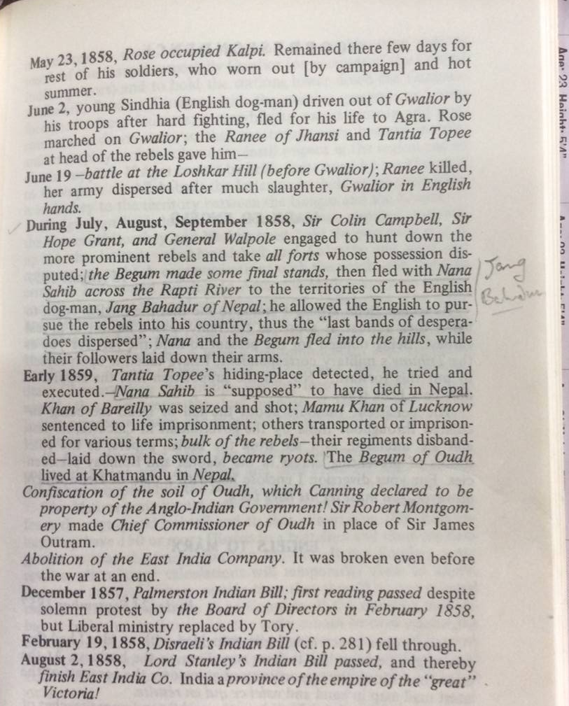
Running dog of British imperialism? (Extract from Karl Marx’s notes on the aftermath of the revolt, published in Marx Engels – The First War of Independence 1857-1859)

