Slide 1
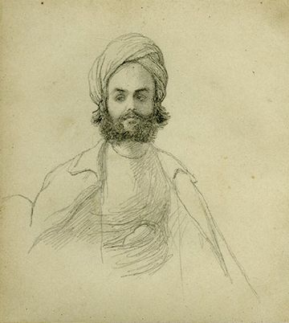
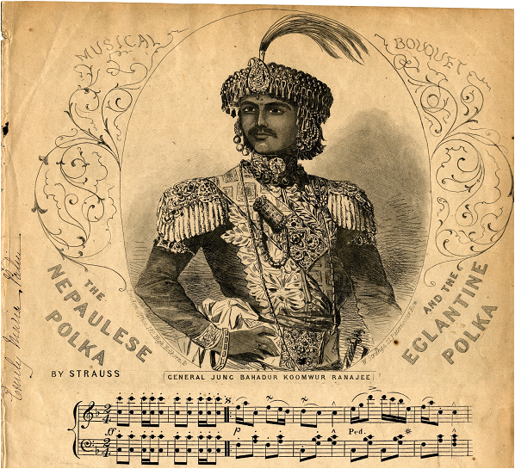
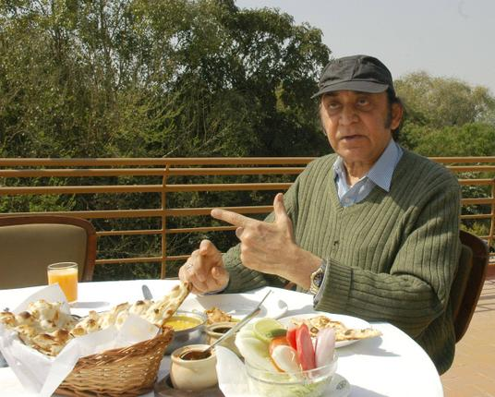
ANTHROPOLOGY IN REVERSE: SOUTH ASIAN VISITORS IN 19th CENTURY LONDON John Whelpton Hong Kong Anthropological Society, 10/2/16

Slide 2
HISTORY OR ANTHROPOLOGY?
`The past is a foreign country. They do things differently there.’
L.P.Hartley, The Go-Between

Slide 3
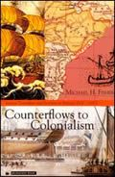
SOUTH ASIANS IN BRITAIN – THE START OF A LONG STORY
Fisher, Michael H. 2004. Counterflows to Colonialism: Indian Travellers and Settlers in Britain 1600-1857. Delhi: Permanent Black,

Slide 4
FOUR IN FOCUS
Jang Bahadur Kunwar Rana (1817-1877): prime minister (1846 – 56 and 1857-77) and Maharaja (1856-1877) of Nepal. In London and Paris in 1850 as ambassador to the United Kingdom.
Sheikh Lutfullah Khan (1802 - ?): secretary and interpreter under the East India Company and Indian princes. Visited London in 1844 in the suite of Mir Jafir Ali Khan, claimant to the Nawabship of Surat
Dilip Hiro (c.1945 - ): arrived in Britain as a student towards 1960, now based both there and in the USA. Best-known as journalist, author and expert on South and Central Asia and the Middle East.
Moti Lal Singh (1795 - ?): served in the Nepali and British Indian armies, recruited by Jang Bahadur’s party when they encountered him working as a crossing sweeper outside St. Paul’s in London

Slide 6
Nepal and British possessions on the eve of the 1814-16 war

Slide 7
NEPAL, BRITAIN AND THE RANA REGIME
1768-69 Gorkha conquest of the Kathmandu Valley
1792 Chinese invasion of Nepal
1793 Kirkpatrick Mission to Kathmandu
1802-03 Captain Knox in Kathmandu
1809-10 Sikh ruler Ranjit Singh halts Gorkha expansion in the west
1814-16 War between the East India Company and the Gorkhas – formally ended by the ratification of the Treaty of Sugauli at Makwanpur on 4 March 1816
Jang Bahadur Rana becomes prime minister following the Kot Massacre
1850 Jang Bahadur’s visit to Britain and France
1856 Jang becomes Maharaja of Kaski and Lamjung
1857-58 Nepal assist’s the British in suppression of the `Indian Mutiny’
1877 Jang’s death
1885 Shamsher Ranas seize power
1951 Rana regime ended by alliance between King Tribhuvan, the Nepali Congress and India.

Slide 8
PERSPECTIVES ON THE 1850 VISIT
The Belait-Yatra account, probably by a member of the Nepali party
British accounts in newspapers and the memoirs of British officials, especially Cpt. Orfeur Cavenagh, the liaison officer attached to the mission.
The New Monthly Magazine article by Moti Lal Singh, apparently by a Nepali recruited by the embassy in London with help from another member of the mission and from one or more British ghost-writers

Slide 9
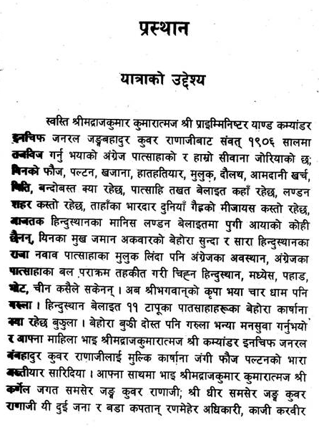
The opening of the Belait-Yatra in Kamal Mani Dixit’s edition (Kathmandu, Sajha Press, 1957/8)

Slide 10
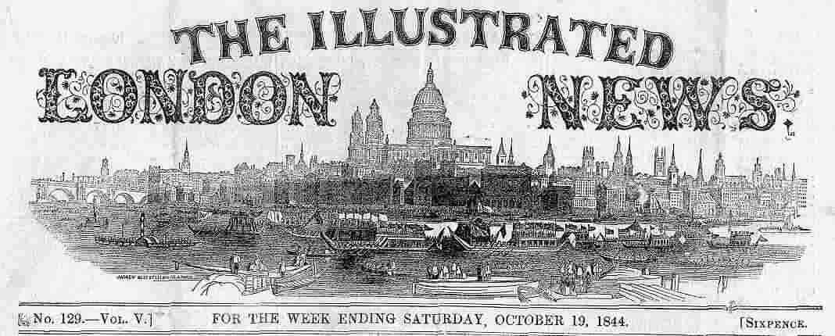
Masthead of the Illustrated London News, whose drawing of Jang Bahadur was widely copied in Britain and France

Slide 11
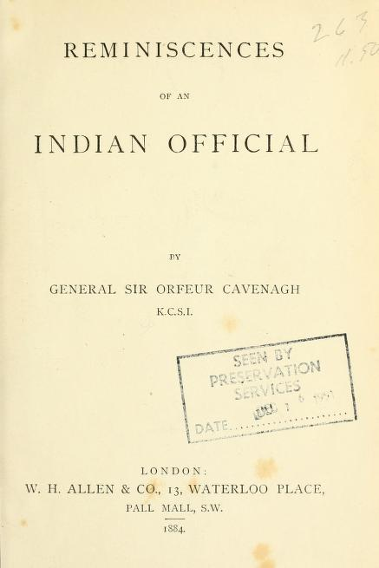
Memoirs of the British liaison officer who accompanied the embassy.

Slide 12
Letter in Jang’s own handwriting from London, instructing his brother how to deal with trouble-makers.

Slide 13
Moti Lal Singh’s July1850 New Monthly Magazine article, published in Nepali translation by Krishna Prasad Adhikari (2013)

Slide 14
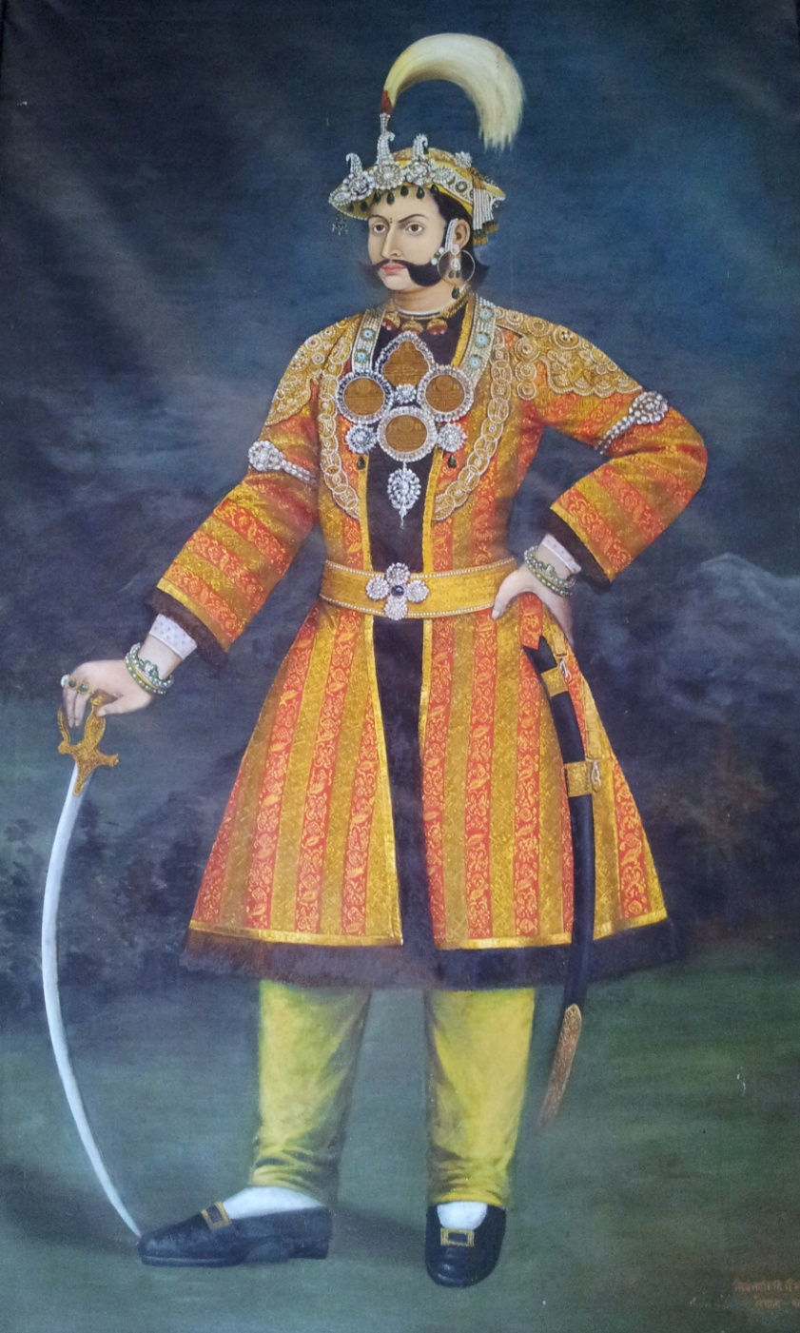
Bhimsen Thapa, mukhtiyar 1806-1837, and his nephew (and Jang’s uncle) Mahbar Singh, prime minister 1843-1845

Slide 15
Jang’s Objectives
Presented by the Belait-Yatra as a fact-finding and goodwill mission
The real agenda:
Conciliating the British now all of India was under their control?
Ensuring Jang’s personal position?
Concrete requests:
Extradition of absconding revenue collectors
Permission to employ British engineers
Right to by-pass the Resident and correspond directly with London

Slide 16
Portrait of Jang painted in 1905 V.S. (1848/9) by Bhajuman, the court artist who later accompanied him to Europe. (Reproduced by courtesy of Majarajkumar Mussories Shumshere J.B. Rana)

Slide 17
Portrait of Jang painted in London in 1850. Copies hang in both the South Asia Reading Room at the British Library and in the Keshar Mahal in Kathmandu

Slide 18
Jang Bahadur, Dhir Shamsher and Jagat Shamsher in London – unknown artist

Slide 19
Lord John Russell (eighth from the left ) and Lord Palmerston (seated in front of the map) in the Coalition Cabinet of 1854 (painting by G. Gilbert, reproduced by courtesy of the National Gallery)

Slide 20
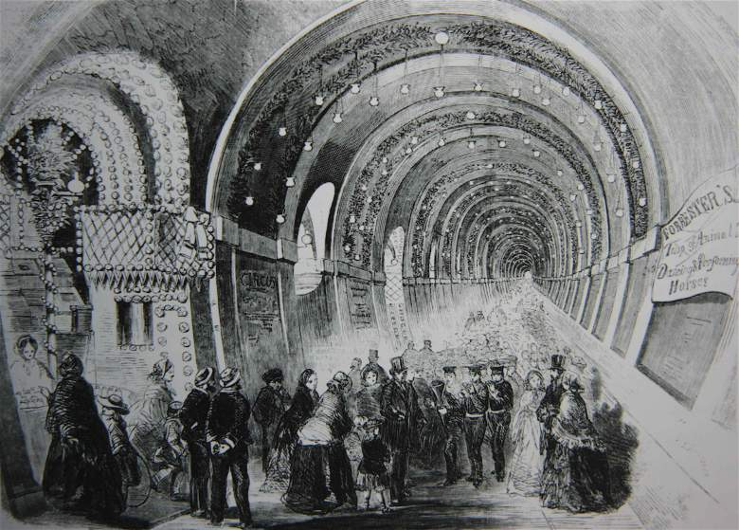
A Fair in the Thames Tunnel (1845) http://russiadock.blogspot.hk/2015/09/marc-brunel-in-rotherhithe-construction.html

Slide 21
HMS Albion, the ship which Jang Bahadur inspected at Plymouth. It is shown here with damage to its masts inflicted by Russian artillery during the Crimean War. (Picure by Louis Le Breton, National Maritime Museum)

Slide 22
The `Indian Mutiny’ – Jang at Lucknow: `When he arrived with his Gurkhas, Jang Bahadur told Campbell `had he not visited England, he would now have been fighting against us instead of with us.’ (Diary of Sir Frederick Traills-Burroughs, quoted in Christopher Hibbert, The Great Mutiny-India 1857, Penguin Books, London, 1980, p. 428)

Slide 23
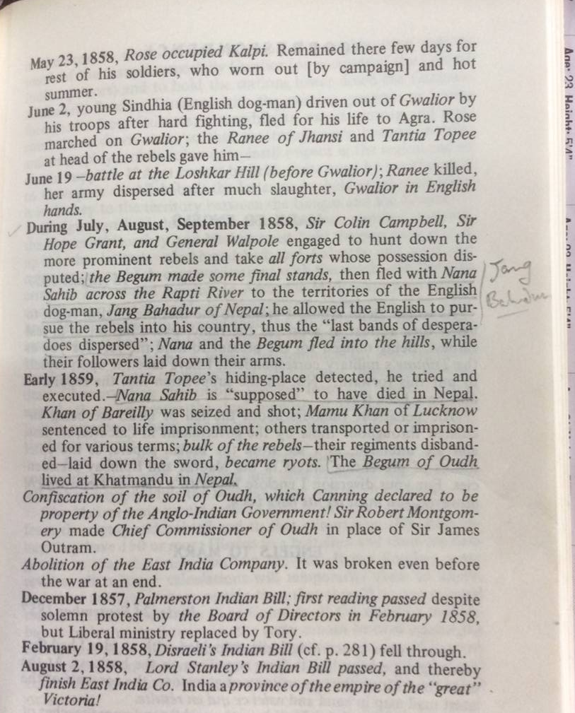
Running dog of British imperialism? (Extract from Karl Marx’s notes on the aftermath of the revolt, published in Marx Engels – The First War of Independence 1857-1859)

Slide 24
South Asian solidarity?
Some Panjabi merchants, British subjects since the annexation of the Panjab the year before, called at the British embassy and got into an argument with Jang on the likely duration of British rule in India. They maintained that ‘India was at sleep at present, but that ere long she would awake.’ Jang replied that India would never be free while Britain remained a leading power in Europe as ‘the English, though few, were men, while Hindustanis were women.’
Reminiscences, p.148
When they saw Indian people and the city of Bombay it felt as if they were back at home with their own families and they were very happy.
Belait-Yatra, p.182
Visited in Benares by an ex-Raja, after a very short time he politely but
firmly told the man he must go, remarking after to Cavenagh, ‘That’s the way to get over an interview with a native’.
Reminiscences. p.175

Slide 25
Reservations about the British
Cavenagh realised that, despite all his public protestations of friendship, he retained considerable mistrust of Britain’s ultimate intentions towards his country. This came out clearly when Jang explained to him, after their return to India, his reason for not wanting to build a road connecting Kathmandu with the plains. He said that he was sure Britain would one day take possession of Nepal and that if such a road were available for use by the invading force then its builder would go down in history as the author of his own country’s destruction. His attitude was illustrated, too, by the parable he used to give his view of the history of Britain’s involvement in India: when man first invented the axe-blade the oak assured his fellow trees that they were in no danger as long as they remained united, but when the ash agreed to form the axe handle, the oak told the others that there was now no hope for them.
Jang Bahadur in Europe, pp. 98-99.

Slide 26
A Muslim visitor’s criticisms of individuals in 1844.
(on the refusal of Mir Jafir Khan’s British secretary to give up a blanket) `This showed clearly that selfishness was the general character of John Bull.’ (Autobiography of Lutfullah, p.366)
(on onlookers’ behaviour in Southampton) `Our party, it appears, was looked upon by the curious natives as one of the seven wonders of the world, Luckily for myself, I had purchased a Turkish dress at Cairo and therefore found myself safe from being stared at…my companions…were impatient to go to the bazaar; and, immediately after breakfast, they proceeded to the market place in their simple Indian dresses, where they were not only gazed at by all with curiosity, but followed by a crowd. …“Over-curious white devils,” exclaimed our doctor, Badru’d-din, very angrily to me; “they have no respect for caste or age: I have a great mind to pelt stones at them.” – “Don’t you do so, Hakim Sahib,” said I to the old doctor, “or you will bring evil on yourself and the hotel: these people don’t fear anyone, It is true, they are over curious, but, after all, they have done you no harm: let, therefore, well alone.”’(ib. pp.381-2)
(commenting on the behaviour of people on board his steamer in the Mediterranean.) `The fact is that the more you proceed on towards England, the more you find the English people endowed with politeness and civility’ (ib. p.366)
(on a British scholar’s behaviour)`I paid him another visit at his own house, which he never returned, thinking perhaps that he was still in India, and not in the land of freedom, where all are equal.’ (ib. p.398)

Slide 27
Turkish court official (presumably Lutfullah dispensed with the hat).

Slide 28
An illusion sustained?
`Calcutta deemed it useful…to sustain the illusion that … their native land was the emerald paradise… that London was a splendid city whose streets, if not actually paved with gold, were nevertheless broad and clean and orderly.’ (Andrew Ward, Our Bones are Scattered, New York 1996, p.46)
`It seemed as if we were in a dream, or as if this were the heaven where virtuous men went after their death…The people of that country do not carry loads themselves. That is done only by ships, trains and carts. The English lead a very happy life. Nobody wears dirty or torn clothes. No one stays dirty: they wash by rubbing themselves down with soap and water and using a brush, and everyone’s face shines like the moon.’ (Belait-Yatra, translated in Jang Bahadur in Europe, p.142 & 146)
‘All the people here appear prosperous and happy, they cannot have encountered sorrow even in their dreams’ (Subedar-major Shersingh Rana, Mero London Rajtilak Yatra, Benares, 1913, p.11)

Slide 29
Lutfullah’s general impressions
(on the journey from the station to their hotel in London) `Street after street, and square after square, that we passed through for about three-quarters of an hour, were all paved, clean and regular, thronged with the busy inhabitants of both sexes, almost all the females good-looking and the males well-made and active.’ (Autobiography of Lutfullah, p.382-3)
`the country all over is fertile, and the people ingenious, civil, and active…. It cannot be, I am sure, without the will of that one Supreme Being that this small island, which seems on the globe like a mole on the body of a man, should command the greater part of the world… ‘ (ib., p.383-4).
`…[the English] are entirely submissive to the law and obedient to the commands of their superiors. Their sense of patriotism is greater than that of any nation in the world.’ (ib. p.409)

Slide 30
Police patrol in the London slums c.1870 (by Gustave Doré)

Slide 31
Interior of St. James’s Theatre in the 1830s (Painting by John Gregory Crace, Berger Collection)

Slide 32
Parliamentary Supremacy
Who would be bold enough to speak improperly before such a body? For in front of the
members are set huge books which one might suppose contain all the wisdom of the Satya, Treta,
Dvapar and Kali Yugas, all the knowledge in heaven and earth; thus they are able to tell who is
speaking the truth, while if anyone has done wrong, they are ready to punish him. There can be
no unseemly argument in the assembly. One person speaks and then another replies. If an
argument is accepted, then they all show their agreement by saying ‘yes.’ If an argument does
not completely convince, they discuss it, consider the facts of the case, consult the books and
give their verdict. The Parament council does not tolerate wrongdoing on anyone’s part. They can
even replace the sovereign. If the Prime Minister offends, they can dismiss him. If the
Commander-in-Chief offends, they can replace him. Be the lord, duke, general, colonel or
anything else, a man’s rank is of no account if he does wrong. If a regiment mutinies, then the
Parament council brings up other regiments and blows the mutineers to pieces with cannon. The
law establishing this powerful house of God was drawn up by the old ancestor of the English,
Jesu Christ.
(Jang Bahadur in Europe, p. 156-7)

Slide 33
The sovereign’s revenue
The sovereign cannot confiscate anybody’s property, punish anyone, resort to
violence or insult, nor hand out and cancel appointments at his own pleasure, as if he
were absolute master of his own resources. His wealth in fact comes from the
earnings from agriculture of the nobility, the military and the common people, who
give up one half as the King’s share. They also hand over, in the form of excise duty,
some of the proceeds from trade. If people obtain spoils by raiding an enemy country,
they hand them over as the King’s property. If they mine iron, copper, lead, gold,
silver or precious stones, they set aside a share for the King. If enemies come to
attack the country, then the nobles and soldiers defeat them at the risk of their own
lives and so save the nation. They then assign themselves larger or smaller shares
according to the effort each makes and they contentedly and unanimously agree to
accept this as their wages. When the enemy comes the sovereign himself does not
take the field: he neither kills anyone else, nor is he himself killed. It is the nobles who
have to kill or be killed, which is why the treasury is the common property of them all.
(Jang Bahadur in Europe, p. 152-3)

Slide 34
TRADITIONAL HIERARCHY AS ENSHRINED IN THE 1854 LEGAL CODE (`MULUKI AIN’)
`CORD-WEARERS’
Parbatiya: Brahman, Thakuri, Chetri
Madhesi: Brahman, Rajput, Kayastha
Janajati: Newar Brahmans
`ALCOHOL-DRINKERS’
Janajati: most Newar castes, Tamang, Magar, Gurung, Limbu, Rai, Sherpa, Tharu etc.
`WATER-UNACCEPTABLE ’
One or two Newar castes
Muslims, Europeans
`UNTOUCHABLE’
Parbatiya occupational castes: Kami, Sarki etc.
Madhesi occupational castes
Lowest Newar castes

Slide 35
Maintaining Caste at Sea
‘… an animal with an apparently orthodox tail was duly made over to the Nepalese party for execution. The appointed executioner was not disposed to become too inquisitive as to the origin of the shortness of the tail of the fine fat sheep destined to become the dinner of himself and his fellows. Unfortunately, however, amongst the members of the Minister’s suite was as old Kazi under a vow not to indulge in animal food for a certain period; under no circumstances, therefore, could he partake of the repast. This old gentleman, who was of a rather crabbed disposition, insisted on being allowed to satisfy himself that this brethren acted in accordance with their religious tenets. The result of his minute scrutiny established the fact, a fact I am inclined to believe previously, if not actually known then very shrewdly guessed by all his comrades, that the animal they were about to sacrifice had in fact been born with a long tail, and that the tail had been docked. Outwardly great was the astonishment manifested. Inwardly, I fancy, many were the curses against their friend’s officiousness.’
Reminiscences, p.115-6

Slide 36
…and on a rail journey
`Whilst the train, was stopping at the Castle station, an incident occurred which illustrated a characteristic of the religion of these Oriental visitors. His highness being thirsty the interpreter inquired for some water, and, in the emergency, one of the porters hastily procured it in one of the men’s coffee cans. This not being accepted, and the porter supposing the vessel was too plebeian for his highness to use, a clean tumbler, containing the pure element, was tendered, but also solemnly rejected. In this dilemma his Highness, or Magnificence, as the splendour of his costume would warrant his being styled, caught sight of the stand-pipe and hose by which the engines are supplied with water, and supposing it to be a spring, endeavoured to find where he could dip in his own drinking-cup, and procure water unpolluted by contact with any vessel in Christian use. The whole party curiously examined the water-pipe, but of course could make nothing of it, and returned to the train with his Highness's want unsatisfied.’
From an un-named Lancaster newspaper, quoted in T Smith, Five Years’
Residence at Nepaul, op cit.. Vol. II, pp. 132-3.

Slide 37
Vauxhall Pleasure Gardens (Punch, July 1850)

Slide 38
Jang with Laura Bell, as recently imagined by Hari Prasad Sharma

Slide 39
The dancer Cerito, celebrated recipient of Jang’s generosity in Paris

Slide 40
Lutfullah on the fair sex
(during 3 days quarantine at anchor in the Solent) `Early in the morning, a friend of mine, Mr Renell of the Bengal Service coming to my cabin, roused me up from sleep, telling me that there were some native girls to be seen near our vessel.… On the left we had a beautiful view of the main land, and on the right we had the Isle of Wight, a magnificent hill with its white cliffs reflected in the sea. At the same time there were lying several small boats near our vessel, which, among other spectators, contained several fresh and fair damsels of England, of very dazzling beauty, so it appeared to me at least.’ (p.379)
`…we had the pleasure of being introduced to Viscount Jocelyn and his wife, the loveliest of English beauties. After a little while I had the honour of playing at chess with this nymph of Paradise. I played two games with her, and allowed myself to be beaten both times to please her. (p.397)’

Slide 41
Dilip Hiro on his experience coming to Britain in the 1950s:
‘... .for the first few months, my critical faculties were, to say the least, underdeveloped. All girls appeared beautiful to me. There was an apparent confusion in my mind— something that I shared with most people from the Indian subcontinent— of equating fair skin with beauty. To me, then, being white meant being beautiful. It was only after many exposures to a bevy of young women in dance halls that I began to distinguish the plain-looking from the merely presentable, and the attractive from the really beautiful....’
In Bhikhu Parekh (ed.). Colour, Culture and Consciousness: Immigrant Intellectuals in Britain, London, Allen & Unwin, 1974, p. 20.

Slide 42
A dispassionate analysis of 20th century dance halls
They functioned like markets, acutely sensitive to supply and demand, in which people were constantly being judged on their physical attractiveness. Early in the evening there were more females and you could dance with any girl you wanted. Later on the men came in from the pubs and there was a great rush to get someone to walk home with.
Dilip Hiro, ib.

Slide 43
Lutfullah on gender relations
`Seclusion of women from the society of men is considered a fault by the English, but a virtue by us, the true believers. The English leave their women uncontrolled in life and permit them to enjoy the society of men both in public and in private. Poor creatures! Naturally weak, how many of them fall victim to the brutal intrigues of men! How many families of high name have been ruined by this unreasonable license!’ (p.321)
`Whilst the females whirled round in their dancing, their gowns flew up to the forbidden height. Tantalizing the assembly it appears was their principal aim by such a violation of decorum.’ (pg. 386)
`[Englishmen’s] obedience, trust, and submission to the female sex are far beyond the limit of moderation. In fact, the freedom granted to womankind in this country, and the mischief arising from this unreasonable toleration is most deplorable’ (pg.409)

Slide 44
The Muslim impact on the Indian view of sex
`[Indians in pre-Muslim times] dressed scantily, as was comfortable in their climate, but adorned themselves as gaudily as their incomes and caste allowed…Their religions were frank in acceptance of all aspects of life and nature.. and sexuality [was] openly acknowledged as central to all. …[Muslims’] style of dress was to cover the body fully, and they believed that modesty required this. .. sex had no part in creation, and females (and the delights associated with them) should be kept decently out of sight in purdah.’ Nicholas Ostler, Empires of the Word, pp. 212-13

Slide 45
Gender relations: the range within Nepal
Used to complete freedom in the choice of lovers before marriage, Sherpas have never developed the feeling that there is any inherent merit in sexual exclusiveness. Just as husbands do not mind sharing their wife with a brother – or a wife sharing her husband with a co-wife – so they do not look upon extra-marital sex relations with the horror other societies have of adultery… Though a husband has the right to claim from his wife’s lover a fine (phijal) of Rs.30, there are many cases of husbands not exercising this right, but accepting an apology and a bottle of beer… Christoph von Fürer-Haimendorf, The Sherpas of Nepal, pp.73, 82.
During the last decade of the 18th century, the killing of an adulterer by the aggrieved husband was almost compulsory in some castes. According to a rule made by King Rana Bahadur Shah, if the…husband did not kill the adulterer, the former would be considered a napunsak (coward) and was declared unfit for government service. Tulsi Ram Vaidya, Triratna Manandhar, Crime and Punishment in Nepal, p.153

Slide 46
COMPETING VALUE SYSTEMS
Can we see Victorian Britain as an inconsistent half-way house between Lutfullah’s and the Sherpas’ logically consistent stances?

Slide 47
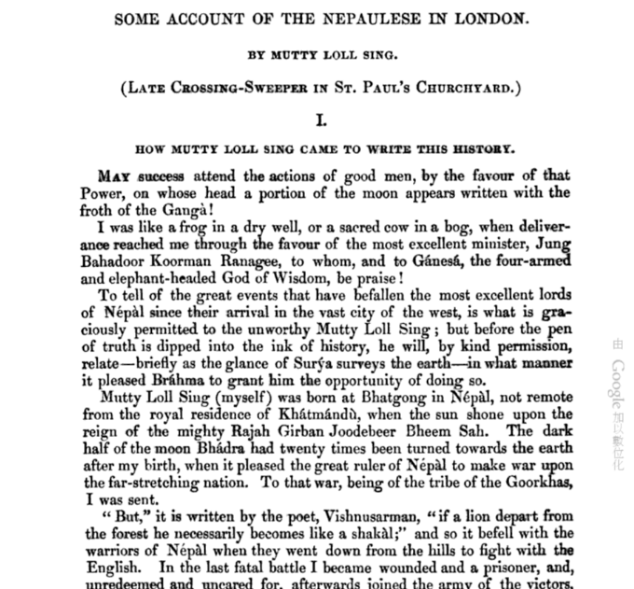

Slide 48
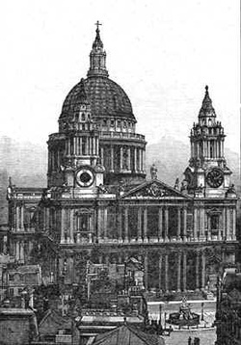
St. Paul’s Cathedral in the mid-19th century

Slide 49
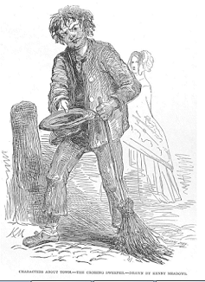
London crossing sweeper (Illustrated London News, 14 June 1848)

Slide 50
Moti Lal – or his editor – analyses the French…
That night we all go to Mitchell’s French Theatre, of St. James’s. On the way
I explain to the excellent minister who are the French, and why they come to
London. “The French,” I say, “are white men – not so white as the English –
with black beards, rolling eyes, and speaking through their noses, or with a
sound in their throats like the gurgling of water as it runs into a tank. They
are a people who do not like sitting quiet on the carpet of happiness; a thorny
seat is their delight. To fight with everybody is their great pleasure; but, most
of all, they like to fight with themselves. Like the monkeys of the forest of
Dandaca, they are always chattering; never at work but in mischief; like
monkeys, too, they imitate all they see, and are the best play actors (Natas)
in the world. The English people are fond of plays, but unable to act them,
oblige Mitchell to invite the French with money. Gladly they come, for none is
to be had in their own country. To this I add, that their food is the flesh of
reptiles.”

Slide 51
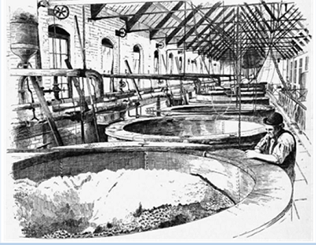
`The vats that hold the porter are of such enormous dimensions that a thousand persons might swim in one with ease, and men are drowned in them daily by scores. This is thought nothing of here, except by these accidents the porter is said to be improved in flavor.’ (Moti Lal’s description of Barclay & Perkins’ brewery

Slide 52
Did Moti Lal go home?
He reached Paris with Jang’s party: : “The Nepaulese Ambassador (who has just left us for Paris, which is so crowded that RUM JUGGUR could hardly find a bed, and SHREE Mutty- ce chère MUTTY, as the French call him – was compelled to sleep in a cookloft)…”. (Punch, vol.XIX , no. 478,1850, pg. 101)
Does he have descendants in Nepal or Calcutta?

Slide 53
PERSPECTIVES ON MOTI LAL
A genuine Nepali and Hindu voice, though partly shaped by experience of Britain
A vehicle for British writers to parody a foreign voice.
In discussion so far, Nepali scholars have tended to go for the first option, non-Nepalis more for the second. Another example of our own situation shaping our views?

Slide 54
Jang Bahadur in Europe is available from the publisher, Mandala Book Point and details of the contents are on the author’s web site (linguae.weebly.com).
http://www.mandalabookpoint.com/main_details.php?sid=395&cat=History
http://linguae.weebly.com/jang-bahadur-in-europe.html

