Slide 1
GREEK SUBJUNCTIVE

Slide 2
OVERVIEW – THE FOUR MOODS
Greek possesses both subjunctive and optative moods, alternative sets of verb forms found commonly in the present and aorist tenses, sometimes in the future (optative only) and rarely in the perfect. The aorist does not take the augment,
The subjunctive and optative seem originally to have been employed to emphasise something happening in someone’s mind (a wish, thought etc.) rather than in reality but this meaning is not obvious in all of their uses. The functions they perform compare roughly to those carried out in Latin by the subjunctive alone, with the Greek subjunctive a little less remote in sense than the optative.
The ordinary verb forms you have been learning so far are known as the indicative mood and the forms for ordering someone to do something (e.g. χαῖρε, χαίρετε) make up the imperative mood.

Slide 3
TENSES OF THE SUBJUNCTIVE
The present subjunctive is formed by lengthening the vowel in the ordinary present tense if short and changing –ου to -ω. Subjunctives are thus easily recognisable except in the 1st p.s. of all verbs in –ω and in the 1st.p.pl. and 3rd.p.pl. of verbs in –α, where contraction produces ω in the indicative also:
  Active: -ω, -ῃς, -ῃ, -ωμεν, -ητε, -ωσι(ν)
  Medio-passive: -ωμαι, -ῃ, -ηται, -ωμεθα, -ησθε, -ωνται
The aorist active, the (rare) perfect active and the aorist passive use the present active subjunctive endings after their normal stems:
  Aorist active: λύσω, λύσῃς, λύσῃ, λύσωμεν, λύσητε, λύσωσι(ν)
  Perfect active: λελύκω, λελύκῃς, λελύκῃ etc.
  Aorist passive: (contraction of -θε- with ending): λυθῶ, λυθῇς etc,
The aorist medio-passive use the present medio-passive endings:
  λύσωμαι, λύσῃ, λύσηται, λυσώμεθα, λύσησθε, λύσωνται
The (very rare) perfect medio-passive uses the perfect participle with the present subjunctive of εἰμί (identical to the present active endings with circumflex and smooth breathing on the first syllable) as auxiliary:
  λελυμένος ὦ / ᾖς / ᾖ λελυμένοι ὦμεν / ἦτε / ὦσι(ν)

Slide 4
MAIN USES
Exhortations
  πρὸς τὴν θάλατταν πορευώμεθα! Let’s go off to the sea!
Deliberative questions
  τί ποιῶμεν; What should we do? ποῖ βαίνω; Where am I to go?
Prohibitions
  μὴ τοῦτο ποιήσῃς Don’t do this! μὴ διαφθείρητε τὴν οἰκίαν Don’t destroy the house
Purpose clauses (subjunctive following present tenses, subjunctive or optative after past tenses)
  ὁ Ἀλέξανδρος τὴν Ἀσίαν εἰσβάλλει ἵνα τὰς Πέρσας νικήσῃ.
  Alexander is invading Asia so that he can conquer the Persians.
  σιγᾶτε ὅπως μὴ ὁ διδάσκολος ἡμῶν ἀκούῃ
  Keep quiet so that the teacher doesn’t hear us
Future vivid (`open’) conditionals
  ἐὰν ἡμῖν συλλαμβάνητε, τοὺς πολεμίους σαφῶς νικήσομεν.
  if you help us, we will certainly defeat the enemy
Indefinite relative clauses
  ὅστις ἂν τὴν πόλιν ἀδικῇ, ἀποθανεῖται Whoever injures the city will die
Indefinite time clauses
  ἐπειδὰν Ἀθήναζε ἴωμεν, τῇ θεῷ εὐχόμεθα Whenever we go to Athens, we pray to the goddess
  ὅταν οἱ πολέμιοι ἀφικνῶνται, μαχουμεθα Whenever the enemy arrive, we will fight
Clauses of fearing (subjunctive following present tenses, subjunctive or optative after past tenses)
  ἄρα φοβεῖσθε μὴ ὁ παῖς ἀποθάνῃ; Are you afraid that the child will die?
  φοβοῦμαι μὴ οἱ στρατιῶται τοῦτο ποιεῖν ουκ δύνωνται Ι am afraid the soldiers will not be able to do this

Slide 5
Present subjunctive – stems in a consonant or -υ
λύω

Slide 6
Present subjunctive – stems in a consonant or -υ
λύω
λύῃς

Slide 7
Present subjunctive – stems in a consonant or -υ
λύω
λύῃς
λύῃ

Slide 8
Present subjunctive – stems in a consonant or -υ
λύω
λύῃς
λύῃ
λύωμεν

Slide 9
Present subjunctive – stems in a consonant or -υ
λύω
λύῃς
λύῃ
λύωμεν
λύητε

Slide 10
Present subjunctive – stems in a consonant or -υ
λύω
λύῃς
λύῃ
λύωμεν
λύητε
λύωσι(ν)

Slide 11
Present subjunctive medio-passive – stems in a consonant or -υ
λύωμαι

Slide 12
Present subjunctive medio-passive – stems in a consonant or -υ
λύωμαι
λύῃ

Slide 13
Present subjunctive medio-passive – stems in a consonant or -υ
λύωμαι
λύῃ
λύηται

Slide 14
Present subjunctive medio-passive – stems in a consonant or -υ
λύωμαι
λύῃ
λύηται
λυώμεθα

Slide 15
Present subjunctive medio-passive – stems in a consonant or -υ
λύωμαι
λύῃ
λύηται
λυώμεθα
λύησθε

Slide 16
Present subjunctive medio-passive – stems in a consonant or -υ
λύωμαι
λύῃ
λύηται
λυώμεθα
λύησθε
λύωνται

Slide 17
Aorist subjunctive passive – stems in a consonant or -υ
λυθῶ

Slide 18
Aorist subjunctive passive – stems in a consonant or -υ
λυθῶ
λυθῇς

Slide 19
Aorist subjunctive passive – stems in a consonant or -υ
λυθῶ
λυθῇς
λυθῇ

Slide 20
Aorist subjunctive passive – stems in a consonant or -υ
λυθῶ
λυθῇς
λυθῇ
λυθῶμεν

Slide 21
Aorist subjunctive passive – stems in a consonant or -υ
λυθῶ
λυθῇς
λυθῇ
λυθῶμεν
λυθῆτε

Slide 22
Aorist subjunctive passive – stems in a consonant or -υ
λυθῶ
λυθῇς
λυθῇ
λυθῶμεν
λυθῆτε
λύθῶσι(ν)

Slide 23
IN INDEPENDENT CLAUSES
(EXHORTATIONS in 1st. person, DELIBERATIVE QUESTIONS, PROHIBITIONS (with μή plus aorist) )
τὸν Φίλιππον ζητῶμεν Let’s look for Philip!
ἐν τῇ πόλει μένωμεν Let’s stay in the city!
τί ἀείδωμεν; What are we to sing?
ἆρα φύγωμεν; Should we flee?
μὴ ἀναγνῷς τοῦτο τὸ βιβλίον Don’t read that book!
μὴ σκοπήσῃς τὴν κὸρην Don’t look at the girl!

Slide 24

πάντες πίνωμεν

Slide 25

οἱ πολέμιοι ἐπιχειροῦσι. σπονδάς αἰτῶμεν;

Slide 26
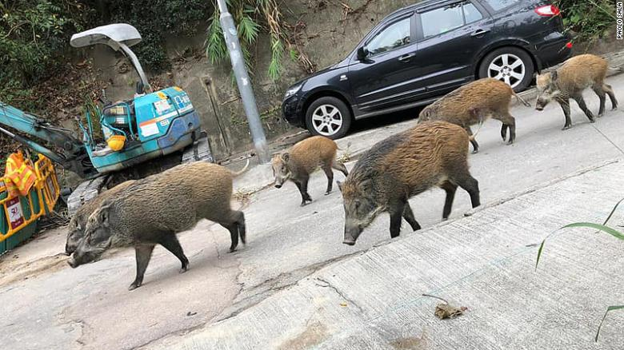
μὴ προσχωρήσῃς τοῖς ζώοισι.

Slide 27
PURPOSE CLAUSES
ἵνα, ὅπως or ὡς plus present or aorist subjunctive after a main verb in a present or future tense and EITHER optative OR subjunctive with a past tense ; μή is added or used on its own for the negative. The examples below show optative alternatives in blue. As with imperatives and infinitives, the aorist subjunctive or optative normally refer to action at a single point in time, the present to something continuing or general.
  σπεύδουσιν ἴνα τὸ δρᾶμα θεωρῶσι.
  They hurry so that they can see the play
  σπεύδουσιν [ὅπως ] μὴ ὑπὸ τῶν πολεμίων λαμβάνωνται.
  They hurry so they will not be captured by the enemy.
  ἔπεμψα στρατιώτας ὡς τῇ πόλει ἀμύνωσι /ἀμύνοιεν.
  I sent soldiers to defend the city
  ἀνδρείως ἐμαχόμεθα ἵνα τὴν πατρίδα σώσωμεν / σώσαιμεν
  We were fighting bravely to defend the fatherland.

Slide 28
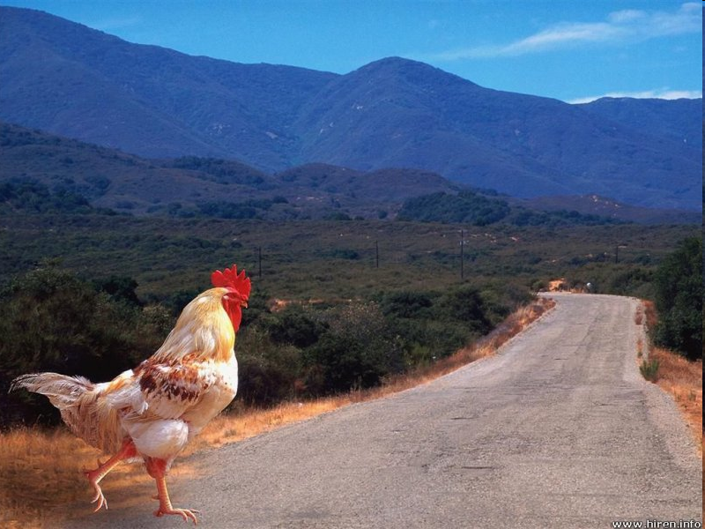
ἐρώτησις· διὰ τί ὁ ὄρνις τὴν ὁδόν ὑπερβαίνει; ἀπόκρισις· ἵνα εἰς τὸ ἕτερο χεῖλος ἀφίκηται

Slide 29
ἐρώτησις· διὰ τί ὁ ὄρνις τὴν ὁδόν ὑπερέβη; ἀπόκρισις· ἵνα εἰς τὸ ἕτερο χεῖλος ἀφίκηται (OPT: αφίκοιτο)

Slide 30

`ὀδόντας μεγάλους ἔχω ὅπως σε ἐσθίω!’

Slide 31
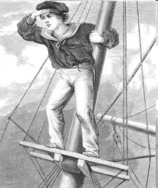
δεῖ τὸν ναυτῆν τὸ ἱστὸν ὑπερβαίνειν ἵνα τὴν γῆν κατασκοπῇ

Slide 32
INDEFINITE CLAUSES
The subjunctive , accompanied by the particle ἄν, is used in subordinate clauses referring to something that may happen at an unspecified time and/or involve an unspecified time or person. The aorist subjunctive is used for events viewed as simple events, the present for continuing action,
Indefinite temporal clauses are introduced by conjunctions meaning `whenever’ (ἐπειδάν (ἐπειδή + ἄν), ὅταv (ὅτι + ἄν), ὁπόταν (ὁποτε + ἄν) ) οr `until’ (ἕως οr (with a negative main clause) πρίν).
  ἐπειδάν ὁ βασιλεὺς λέγῃ, οἱ πολῖται ἄκουσι.
  Whenever the king is speaking the citizens listen
  οἱ παῖδες οὐ σιγῶσι πρὶν ἂν ὁ διδάσκαλος αφίκηται
  The children are not quiet until the teacher arrives
  δεῖ ἡμᾶς μένειν ἔως ἂν ἐπανέλθῃ ὁ στρατηγός
  We must wait till the general returns
Ιndefinite relative clauses may contain the pronoun ὅστις, ἥτις, ὅ τι (whoever, whatever etc.) or, with or without the addition of πάντες, πᾶσαι, πάντα, the word ὅσοι, ὅσαι, ὅσα (literally `as many as’)
  ὅστις ἂν τον παἱδα ἀδικήσῃ, ἀποθανεῖται Whoever harms the child will die
  ἡ θεὸς ἡμῖν δίδωσι πάντα ὅσα ἂν αἰτῶμεν The goddess gives us whatever we want.

Slide 33
INDEFINITE CLAUSES (contd.)
Since the future is by its nature uncertain, the Greeks treated temporal and relative clauses referring to it as indefinite. Consequently English translations may sometimes not use `ever’:
  ἐπειδὰν ἐπανέλθῃ ἡ μήτηρ, δειπνήσομεν
  When mother returns, we will have dinner

Slide 34
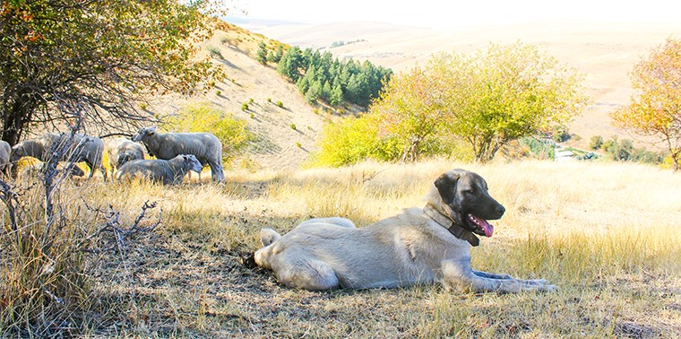
ἐπειδὰν λύκος φάνῃ, ὁ κύων τοῖς προβάτοις ἀνδρείως ἀμύνει.

Slide 35
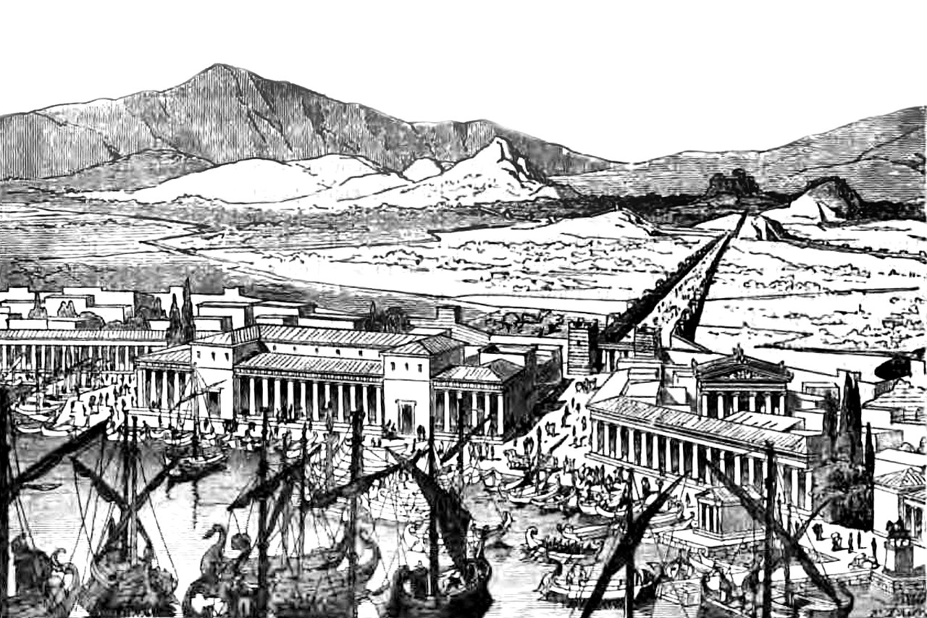
ὅστις ἂν ἔξω τῶν τειχῶν μένῃ, ἀποθανεῖται ὑπὸ τῶν πολεμίων.

Slide 36
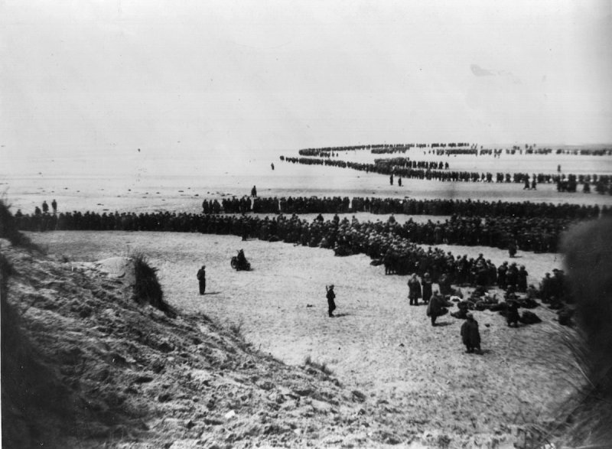
οἱ στρατίωται μένουσιν ἕως ἂν αἱ νῆες ἀφίκωνται

Slide 37
VIVID (`OPEN’) FUTURE CONDITIONALS
Τhe if-clause (`protasis’) of future conditionals thought quite likely to be fulfilled is treated as a kind of indefinite clause, with subjunctive plus ἄν, which combines with εἰ (if) to form ἐάν:
  ἐὰν ἐπανέλθῃ ἡ μήτηρ, δειπνήσομεν
  If mother returns, we will have dinner
  ἐὰν ὁ βασιλεὺς ἡμᾶς αἰτήσῃ, πάντες μαχούμεθα
  Ιf the king asks us, we will all fight

Slide 38
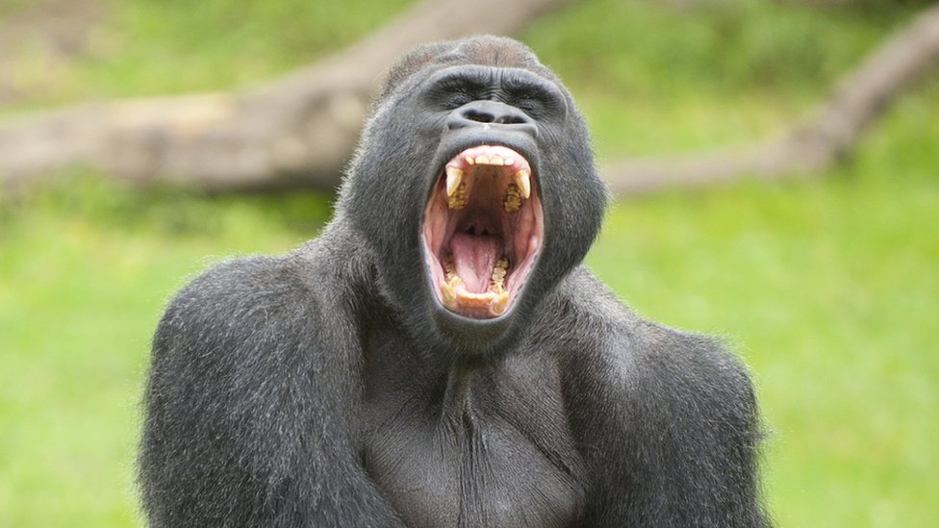
ἐὰν μὴ κινώμεθα, ἡμᾶς οὐκ ἀδικήσει,

Slide 39
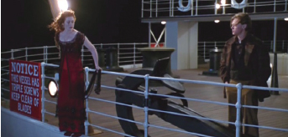
ἐὰν σὺ πηδήσῃς, ἐγὼ πηδήσω

Slide 40
CLAUSES OF FEARING
For fearing something will/would happen, μή plus present or aorist subjunctive is used, with μή.. οὐκ for fearing something will not happen. When the verb of fearing is in a past tense, the optative can be used instead of the subjunctive. Similar clauses can be used also after phrases like κίνδυνός ἐστι (there is danger):
  φοβοῦνται μὴ οἱ Ἕλληνες νικηθῶσι
  They are afraid that the Greeks will be defeated
  ἐφοβοῦντο μὴ οἱ Ἕλληνες οὐκ νικήσωσι
  They were afraid that the Greeks would not win

Slide 41
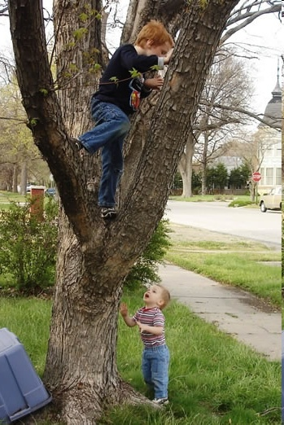
ἀδελφὸς νεότερος· ἆρα οὐ φοβεῖ μὴ πέσῃς; ἀδελφὸς πρεσβύτερος· οὐδαμῶς. φοβοῦμαι μὴ μήτηρ τῆς σῆς φωνῆς ἀκούῃ.

Slide 42
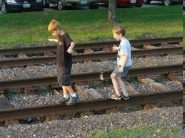
παῖδες μῶροι, κίνδυνός ἐστι μὴ ἀποθάνησθε.

Slide 43
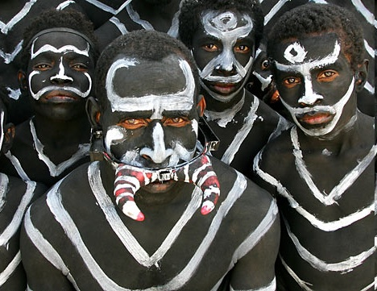
`αὐτοὺς σκοπεῖτε. δεινοὶ φαίνονται. φοβοῦμαι μὴ ἐσθιώμεθα.’

