Slide 1
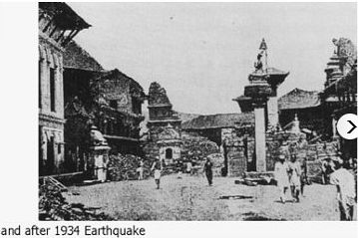
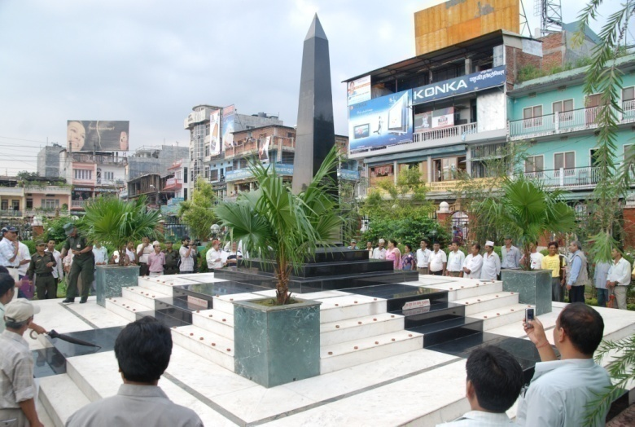
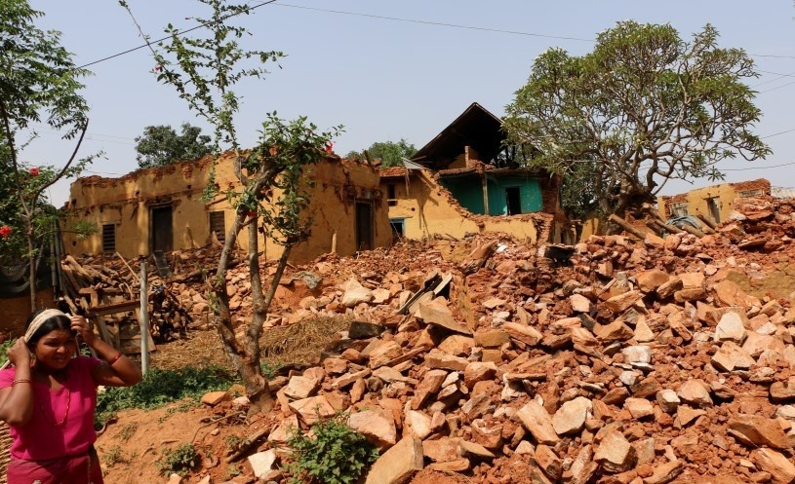
AFTERSHOCKS: THE POLITICAL EFFECTS OF EARTHQUAKES IN NEPAL
John Whelpton Hong Kong (HKAS) 5 July 2019

Slide 2
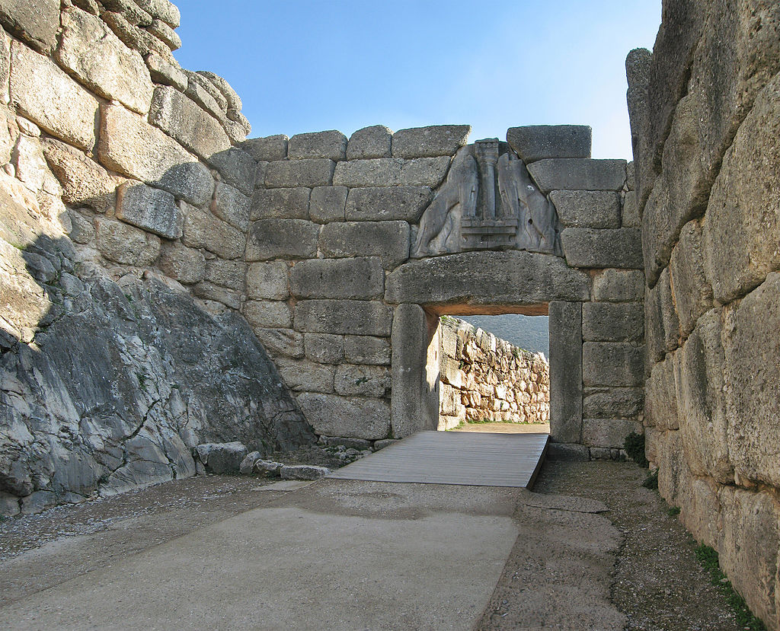
EARTHQUAKES IN HISTORY (after Robinson (2016))
12th century B.C. - a series of quakes a factor in the collapse of Mycenean and other Bronze Age civilisations?

Slide 3
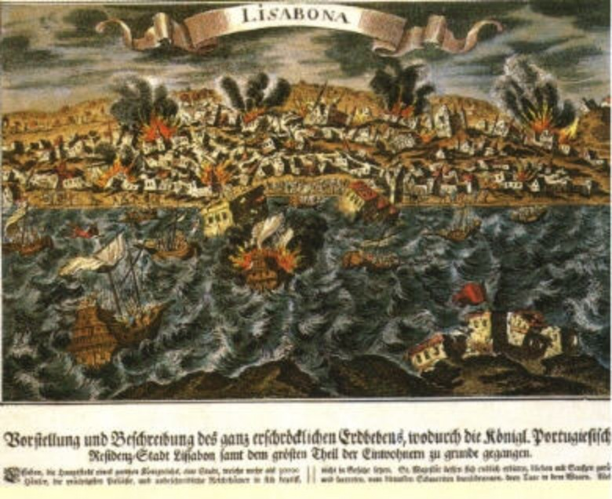
1 Nov1755 – Lisbon Earthquake
30-40,000 deaths in Lisbon, 10,000 elsewhere in Portugal
accelerated the decline of Portugal as a major power
allowed the concentration of power in the hands of the Marquis of Pombal, who expels the Jesuits, undertakes planned reconstruction of Lisbon
Particularly through Voltaire’s reaction, strengthened secularisation of the European intelligentsia.

Slide 4
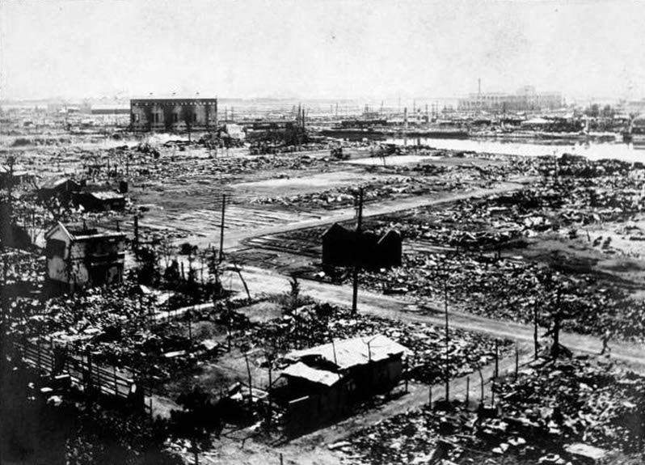
TOKYO/YOKOHAMA 1 September 1923
Between 105,000 and 142,000 dead (mostly from subsequent fire)
The army’s administrative role under ten weeks of martial law (during which some soldiers and police connived in the lynching of 6,000-10,000 Korean labourers), plus subsequent financial problems may have paved the way for military dominance of the Japanese government.

Slide 5
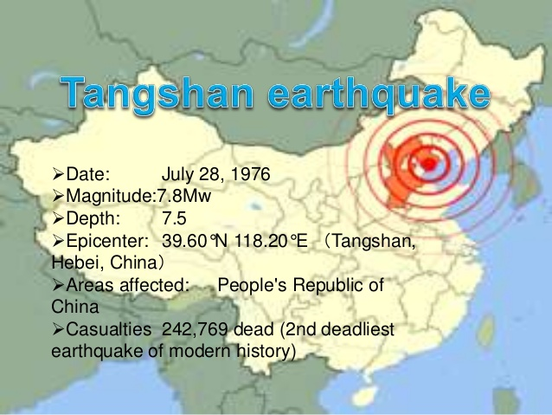

Slide 6
1976 - TANGSHAN EARTHQUAKE
Uncertainty over death total: officially announced figure of 242,000 excluded migrant workers, visitors etc; Taiwan in 1977 claimed to have seen a `secret government report’ giving 655,000 dead; figure of 750,000 extrapolated from similar earlier disaster
James Palmer claims (despite skepticism of many) accelerated downfall of `Gang of Four’ and ascension of Deng Xiao Ping:
Traditional concept of major disaster as sign of withdrawal of `mandate of heaven’
Contradicts government’s claim (following apparent successful prediction of Haizheng quake in 1975) to be able to forecast earthquakes
Some evidence that Cultural Revolution disruption impeded Seismology Bureau precautions
Gang of Four perceived as slow in relief and callous in attitude to victims, regarding issue as secondary to campaign against Deng: `Be alert to Deng Xiaoping’s criminal attempt to exploit earthquake phobia to suppress revolution! Solemnly condemn the capitalist roaders who use the fear of an earthquake to sabotage the denunciation of Deng!’ (Palmer 191)
-

Slide 7
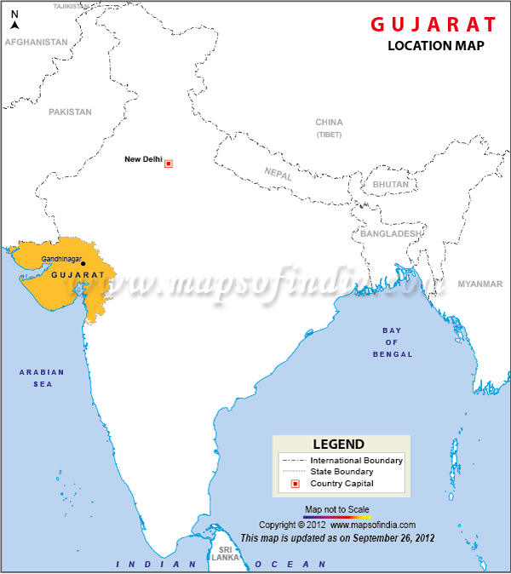
GUJARAT, 26 January 2001
Around 20,000 deaths
Results in the national leadership of the Bharatiya Janata Party, then in power in Delhi and in Gujarat, replacing the state’s chief minister, blamed locally for poor response and corruption, with Narendra Modi.
`Gujarat model’ of rapid industrialisation (with poorer performance on social indicators) is probably only a continuation of previous trends but enables Modi, despite being widely blamed for anti-Muslim violence in 2002, to become a national leader, serving as prime minster of India since 2014

Slide 8
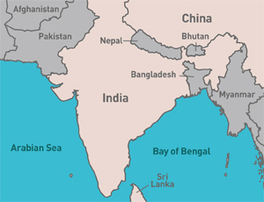

Slide 9
THE ETHNIC MIX
`JANAJATIS’ (TIBETO-BURMANS, MONGOLS) – mostly originally speakers of Tibeto-Burman languages and animists or Buddhists but now often assimilated into Hinduism and speaking Nepali or another Indic language 36%
PARBATIYAS (INDO-NEPALESE, KHASAS) – original speakers of NEPALI (aka Parbatiya, Khas Kura, Gorkhali), normally Hindu. Divided into castes. 38%
MADHESIS – sharing the culture and caste structure of the north Indian plain. Speaking various Indic dialects but often using Hindi as a lingua franca 17%

Slide 11
GORKHA DARBAR

Slide 12
The Japanese and Nepalese monarchies and hereditary premierships
1600: Tokugawa Ieyasu wins Battle of Sekigahara
1603: Tokugawa awarded title of shogun – Emperor remains formal head of state
1868: Alliance between Emperor and a section of the nobility ends shogunate
1945: Emperor formally renounces claim to divinity
1846: Jang Bahadur Rana eliminates rivals in Kot Massacre
1856: Jang awarded title of Maharaja – Shah king (Maharajadhiraj) remains formal head of state
1950-51: Alliance between monarchy and the Congress Party ends Maharajship
2008: Monarchy formally abolished

Slide 14
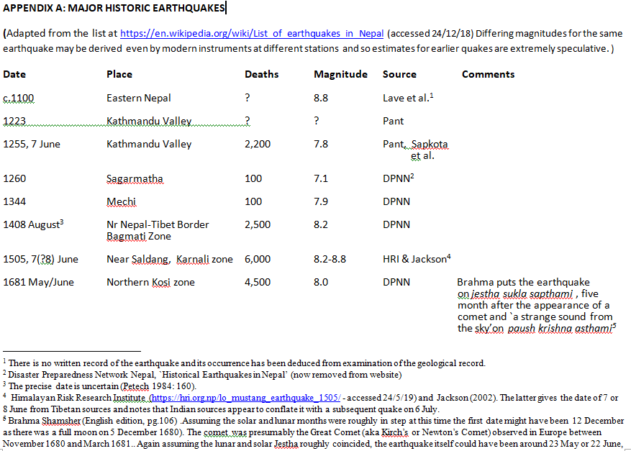

Slide 15
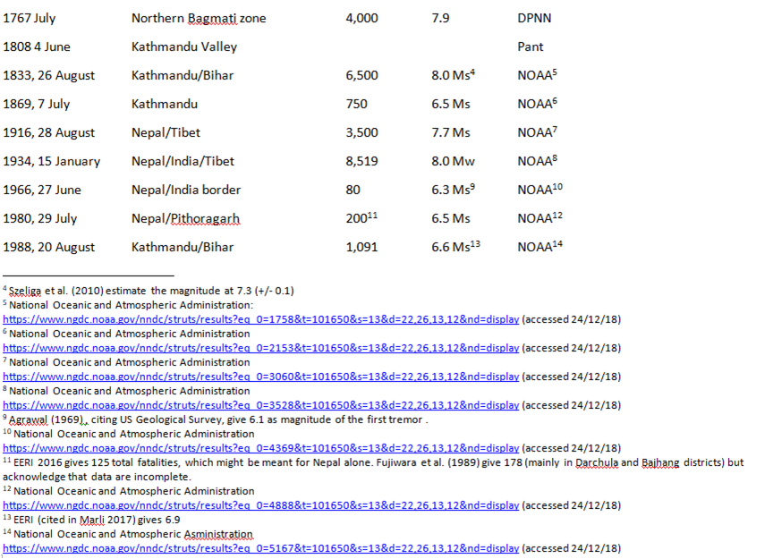

Slide 16
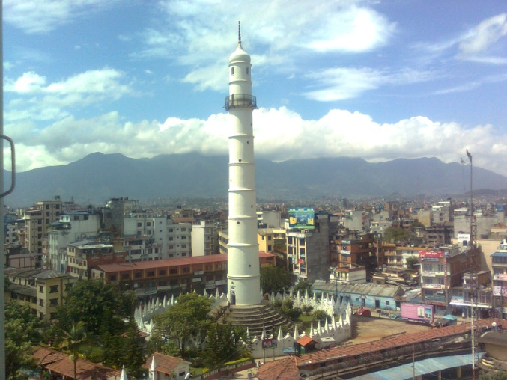
NEPAL: 26 AUGUST 1833 (8.0M?)
`..at 10.48 a third and most violent [shock] commenced: at first it was a gentle motion of the earth, accompanied by a slight rumbling noise; soon however it increased to a fearful degree, the earth heaved as a ship at sea, the trees waved from their roots, and houses moved to and fro far from the perpendicular. Horses and other cattle, terrified, broke from their stalls, and it was difficult to walk without staggering as a landsman does on ship-board. This shock lasted for about three minutes in its fullest force. ’ (Campbell 1833: 564)
British Residency estimate of casualties in Nepal (excludes casualties in India) : 400 dead, 172 injured, 4040 houses destroyed. Public buildings destroyed included minarets erected by minister Bhimsen Thapa in Kathmandu. No details known of government involvement in relief work, no known foreign assistance.
Taken as a portent, the disaster probably accelerated the decline in Bhimsen’s predominance which culminated in his 1837 dismissal (Pradhan 2012: 144-5):

Slide 17
BIHAR-NEPAL EARTHQUAKE 15 January 1934 (8.0)
Death toll in Nepal: 8,219; in Bihar 7,253 (official figures – probably underestimates)
In contrast to India, where the press and the Nationalist movement challenged government figures and measures, written record, including coverage by Indian press and AP correspondent, almost exclusively reflects official Nepali and British viewpoints; foundational published account is by a senior member of the Rana regime, Brahma Shamsher J.B. Rana (The Great Earthquake in Nepal)

Slide 18
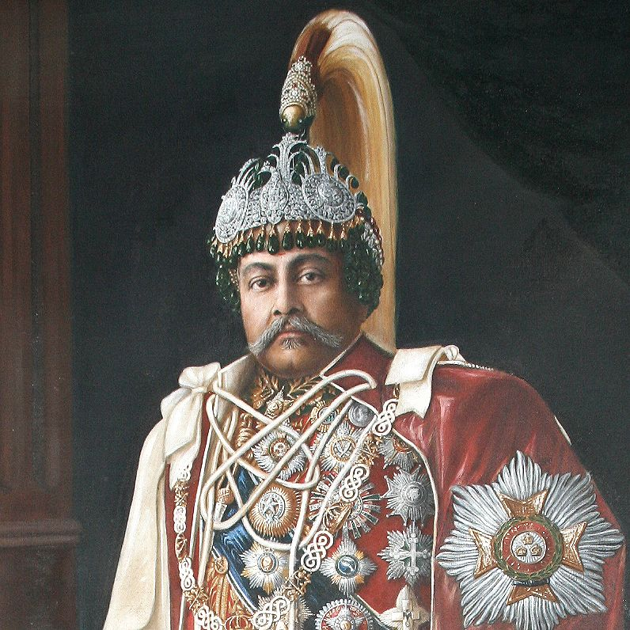
Maharaja Juddha Shamsher Rana (ruled 1932-1945)

Slide 19
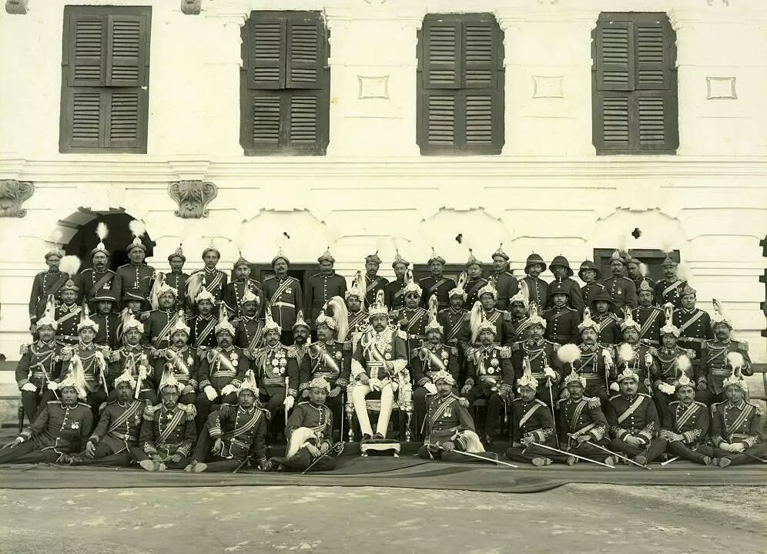
Juddha on his coronation throne with relatives and officials, 1932

Slide 20
Report by British Legation surgeon who gave medical assistance the first two days after the earthquake
`Many of the public buildings were down and all [except the electricity offices] seemed to be so badly cracked as to be unsafe. The hospitals were partly demolished and those remaining were so badly crashed as to be useless.
The city itself was a dreadful sight, At least one house in five had completely collapsed and very few seemed to have escaped uninjured.
Every hundred yards or so the narrow streets were blocked with piles of debris twenty feet high over which we had to climb.
The inhabitants were behaving splendidly; there seemed to be no panic; the people were all hurrying out of the narrow streets towards the various open squares with what goods and chattels they had been able to save and were settling down in family groups in those open spaces preparing to pass the night as best they could.
We worked our way from open space to open space rendering first aid to the injured.
There were many corpses lying about but as yet most of the casualties were buried and we were constantly receiving heart rending appeals to come and dig people out.’

Slide 21
EVALUATING NEPAL’S INITIAL RESPONSE
`For two nights following the earthquake there was considerable looting by large organised bands. Owing to profiteering food stuffs in the Bazaar soared to famine prices. Both these evils were promptly and successfully dealt with by the Nepal Government, with Commanding General Sir Padma Shumshere Jung Bahadur Rana at the head of affairs.. In two days the looting had ceased and prices had dropped to normal.’.(Smith’s April Report)
`They work on a co-operative system whereby a number join together in a mutual reconstruction `combine’ and the owner of the house under repair is the host as regards food.. these hillmen are the most indefatigable workers and it is my belief that most of the hill hamlets will be reconstructed before the Rains.’. (Daukes observations of villagers in hils to the south of the Kathmandu Valley in March )
`Great as is the calamity, Nepal possesses a priceless asset in her sense of national unity which combined with the great energy of her people will in all probability enable her to recover in a surprisingly short space of time.’ (Daukes, ib.)

Slide 22
Reconstruction and preventative measures after the 15 January 1934 earthquake
Reconstruction of public buildings claimed complete by 1938 Sometimes suggested that Juddha cut corners in his hurry to prove that he could rebuild Nepal virtually unaided,
No evidence for government enforcement of recommendations by British geologist John Auden and by a Nepali engineer published in the official government newspaper and in Brahma Shamsher’s book.
However, some of the elite built low, earthquake-proof accommodation in their gardens and King Tribhuvan continued to sleep in his.
British Minister wrote in 1937 that the homes of the poor had been poorly rebuilt Some of the reconstructed homes of ordinary people may in fact have been an improvement as a Japanese survey reported that houses in Bhaktapur rebuilt after the 1934 earthquake were not among those that collapsed in 1988. (Fujiwara et al. 1989: 45)

Slide 23
A premature forecast?
`About April 22nd the astrologers of Nepal predicted that as 6 planets would join together in the first sign of the Zodiac Aries between 4 p.m. and 10.30 p.m. Friday April 25th, a catastrophe similar to the great Earthquake might be feared. (This was also reported in some Indian newspapers). Having had the terrible experience of the last Earthquake, when 7 planets had joined together, the Nepalese government closed their offices on this date and warned the people to be alert and to keep out of doors as much as possible. Many of the Rana family pitched tents in their gardens and moved into them. Nothing however happened and the day passed off peacefully.’

Slide 24
OFFERS OF EXTERNAL ASSISTANCE
Request for specific, short-term technical assistance (following Bhimsen Thapa’s example in the 1816 smallpox epidemic?)
Declining aid which might strengthen the belief that Nepal was de facto a part of India or lead to an influx of British relief workers
the United Provinces government offer of material aid
Assistance through the Viceroy’s Relief Fund (the Government of India was privately averse to setting up a separate fund for Nepal)

Slide 25
THE DECISION TO WAIVE REPAYMENT OF HOUSE RECONSTRUCTION LOANS
`…in July [1938].. the Maharaja intended to enforce, by legal pressure, the repayment of loans given by him to sufferers after the earthquake of 1934. At a council convened for this purpose, the sons of the late Sir Chandra at first advocated leniency and suggested that repayment should be calculated on the basis of amounts borrowed. They pointed out the extreme poverty of the people, many of whom had not recovered from the effects of the earthquake, had mortgage their houses in their efforts to pay back the loan, and would probably rebel if pressed further. His Highness was not inclined to relent, but when he saw that Sir Mohan Shumshere and his brothers intended to remain firm, he realised his position would be weak between the people on one side and the Chandra family on the other. Eventually he resiled completely, and decided to write off the original loan of 30 lakhs rupees.’ (From British Minister Geoffrey Betham’s annual report for 1938)

Slide 26
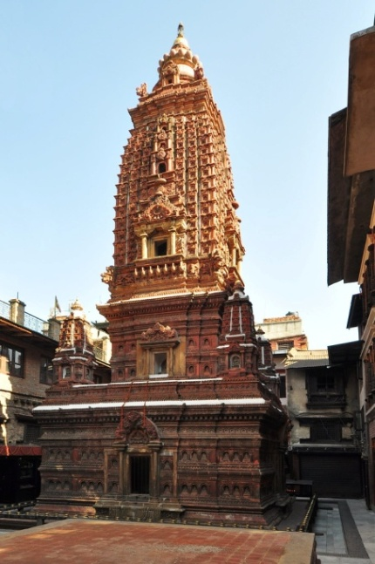
The Alternative Explanations
Action under political pressure from the Chandra branch of the Rana family? (Geoffrey Betham, British Minister in Kathmandu)
Juddha had intended to waive repayment from the start but initially packaged relief initially as loans to prevent people requesting excessive amounts (Juddha’s daughter, Janak Rajya Laxmi Devi, interviewed by Stefanie Lotter, 1999.)
Juddha himself feeling obliged to treat other loans similarly after spontaneously announcing at the inauguration ceremony of the reconstructed Mahabouddha temple in Patan the waiving of the management trust’s reconstruction loan. (Mukunda Raj Aryal, cultural historian, interviewed 2017)

Slide 27
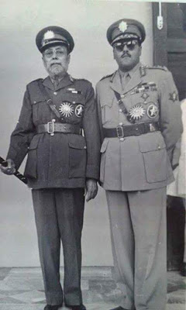
Political consequences (I): 18 March 1934 purge of the `C-class’ Ranas (illegitimate sons of previous maharajas)
Action long under discussion but accelerated by the earthquake, which occurs while he is hunting in western nepal.
Juddha reveals his decision to `A-class’ Ranas (born of regular marriages) on 2 Feb, two days before reaching Kathmandu
C-in-C Rudra Shumshere (below with son Kiran) and the other C-class Ranas on the roll of succession are aware action is imminent but decide it’s useless to resist

Slide 28
Political Consequences (II) Effect on public opinion?
Educated citizens, like many in India, blamed the earthquake on the conjunction of planets in one constellation, ordinary people on divine anger at Lord Clydesdale’s 1933 Everest flight authorised by Bhim and Juddha
D.R.Regmi’s accusation that most of the relief loans went to Ranas themselves – reflecting gossip in Kathmandu or propaganda amongst the diaspora?
Hem Prasad Timilsina, survivor of both 1934 and 2015: `They didn’t do much for us that time either!’

Slide 29
Earler British reports of discontent stress only pre-existing factors
`...there are already some indications of discontent from outlying districts in the hills where the feeling is gaining ground that Nepal is being exploited in the interests of one family (the Ranas) and of one valley, i.e. that of Kathmandu. These Mongolian hillmen are, by nature, long enduring and the murmurings are still faint but they are audible.’.(Daukes to Sir John Simon, Jan. 1935)
`Not until after the War of 1914-1918 was anything done to improve the communication into Nepal. Since then the Nepalese railway between Rexaul and Amlekhgunj, a good motor road between Amlekhgunj and Bhimphedi and a vastly improved track from there to Thankot with a motor road into the capital were built…With the hideously uncomfortable journey to face between Raxaul and Katmandu in former days only those forced to travel moved between India and Nepal. Now there is a continual stream of traffic up and down the road.’(Betham to Halifax July 1940)

Slide 30
Political consequences (III) The army – British Resident claims in his report for 1940
Discontent in the army over Juddha’s refusal to waive repayment of their 4 months advance of pay in the same way as civilian loans
Juddha said to have been almost relieved at outbreak of war in 1939 as the most disaffected regiments could be included in the 8 sent for garrison duty in India
Troops unsuccessfully petitioned on the eve of departure for reimbursement

Slide 31
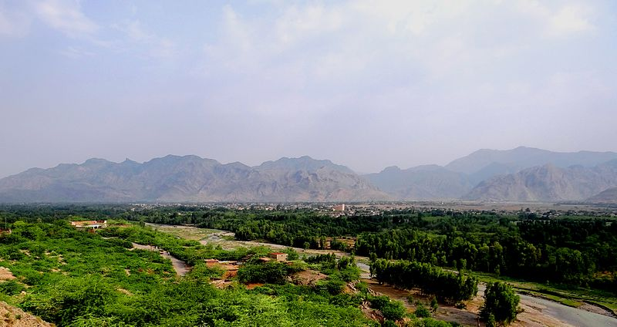
The Kohat Incident

Slide 32
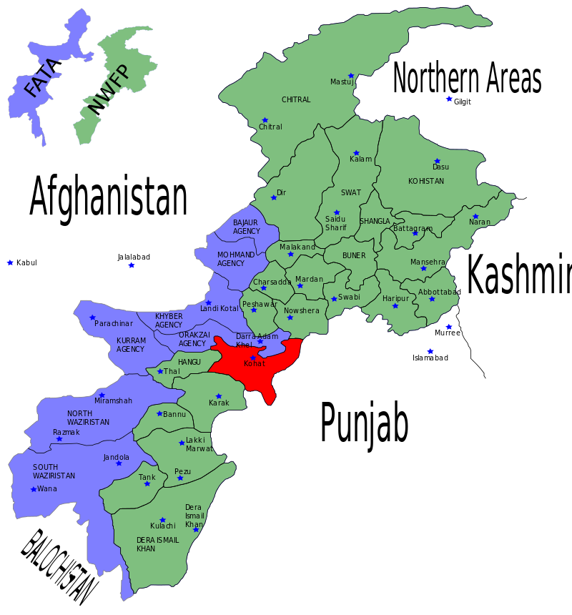
Kohat (in Pakistan’s present-day Pakhtunkhwa-Khyber province)

Slide 33
The Events (Uprety 1984, Betham’s Report for 1941)
Battalion stationed at Kohat riot on 1 January over a supplementary ration given in kind rather than cash
Officers unable or unwilling to restore order – five Nepali and the attached British officer slightly injured
British district commander secures armoury
Bahadur summoned from Delhi. The unit is paraded (with armed British and Indian units nearby) and obeys order to ground khukuris
22 ringleaders arrested and sent to Kathmandu, Subedar Megh Bahadur Thapa hanged at noon on the Tundikhel.
Some of the Nepal officers publicly beaten in Kathmandu
The unit temporarily disarmed, later used as a demonstration battalion under British officers

Slide 34
UNDERLYING CAUSES
All sources agree on command failure by unit’s officers. British Indian army officers emphasise this, arguing, against protests by Juddha and the British Government of India’s Foreign Department, that unit concerned should be kept under British Gurkha officers
Uprety and oral tradition within Nepal Army suggest cultural adjustment problems – latter sometimes specifically blaming the Muslim environment – and suspicion meat supplied might be beef
Betham cites earthquake advance grievance and highlights C-class Ranas among the inadequate officers

Slide 35
Wider disaffection in the army (Undated intelligence report – Jan/Feb 1941?)
`Discontent is obvious and it was somewhat of a shock to me when a short time after the arrival of the Nepalese in India, I invited a few of the [Thakuri and Chettri] officers to my house, they immediately with one accord commenced to expound the evils of the present system’
Particular resentment against the restrictions imposed on them by the `Guru Maharaj’ or `Pope of Nepal’, who they saw as partially controlling Juddha.

Slide 36
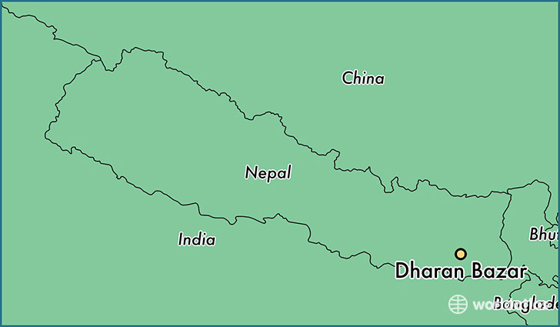
NEPAL – 21 August 1988 (6.6 M)
Affected primarily in the eastern hills and the city of Dharan but some around 1750 houses destroyed or rendered uninhabitable in Bhaktapur in the Nepal Valley
721 dead (plus c. 400 in adjoining areas of India), around 60,000 homes completely or partially destroyed.
Foreign financial assistance actively sought, in contrast to 1934, but, as before, government anxious to retain full control of relief activities.

Slide 37
Reconstruction after 1988
House rebuilding loans of 5000 rupees at 1% interest were offered, with option of an additional 5000 at 10% and 15% on anything beyond 10,000. 53,000 households benefited. In 1992 the government cancelled repayment of the basic 5000 rupees for all who had bororwed no more than 10.000. Those who had borrowed higher amounts often then withheld repayment in the hope that their loans also would eventually be forgiven (World Bank 1997)
Free technical advice for village homes and grants for installation of toilet and smokeless stove (features compulsory in towns) but only a minority of rural households took this up.
A World Bank credit of US$41.5 million agreed in April 1989 for a programme under a Town Development Fund Board covering both reconstruction and an urban development scheme already under discussion before the quake but the urban development component was not successful because of poor absorptive capacity of the municipalities.

Slide 38
Safety initiatives following the 1988 earthquake
Focussed attention both from professionals and in the Kathmandu media on the earthquake safety issues
Drawing up of a National Building Code made compulsory in urban areas in 2005. But apparent after 2015 quake that enforcement had been weak.
Institution of an annual Earthquake Safety Day in1999.
Production of educational materials for schools, including the Red Panda videos. Many programmes were of high quality but coverage inadequate. Research after 2015 found that most earthquake victims had been unaware of the internationally endorsed `Drop, Cover and Hold on’ advice that had been emphasised in Nepal from 1988 onwards.

Slide 39
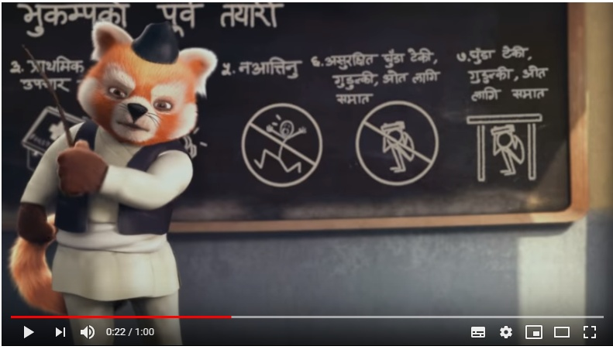
Disaster Risk Reduction: Red Panda PSA (US Embassy/Ministry of Home Affairs 2013) English version of video: https://www.youtube.com/watch?v=B_uSwAXkerA

Slide 40
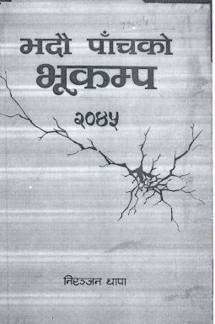
Bhadau Panchko Bhukampa (Earthquake of 5th Bhadau), self-published monograph by Niranjan Thapa, State Minister for Home Affairs from March 1988 to March 1990
`

Slide 41
Thapa’s Perspective
Acknowledges difficulties of getting to remote areas and communication problems but portrays the government effort as highly appreciated by the victims
Particularly gushing in references to the royal family:`In Her Majesty [Queen Aishwarya]’s actual presence, it seemed that in this country there are no children without parents, no orphans, that all Nepalis are safe in the sacred, pure and broad shade of the monarchy’ (Thapa 1989: 82)

Slide 42
Opposition perspectives
Accusations of inefficiency and corruption, including the waste of expenditure on inspection tours by senior Panchayat politicians.
Indignation over government’ preventing opposition participating collectively in blood donation, fund collection or relief activities.
Criticism of the appeal for foreign assistance from former minister turned dissident, Rishikesh Shah:
`Even before full details about the extent of loss of life and property caused by the earthquake are available, both the Finance Minister and the Minister of State for Home have appealed for international assistance. This clearly reveals that the Marich Man Singh regime lacks a spirit of self- reliance and is totally helpless. The finance minister has gone so far as to demand blankets and helicopters. As many as 7000 people had died in the 1934 earthquake, and foreigners had offered relief aid, but the then rulers of our country had refused to accept it. But today, we are dependent on foreign assistance not only for economic development but even for the relief of disaster victims. Is not this shameful for us?

Slide 43
The Murder of Karna Hyaju
Former member for Bhaktapur of the Rastriya Panchayat , elected in 1981(first direct election to the apex body of the officially partylesss system) as de facto candidate of the Nepal Majdur Kisan Parti (Nepal Workers and Peasants Party), which dominated local politics.
Succumbs to establishment overtures, loses support of the party, whose new candidate wins the seat in the 1986 election.
Four days after the earthquake is accused of favoritism in relief distribution in Bhaktapur, attacked by a crowd and killed, Party activists allege this was a `false flag operation by `Mandales’, thugs aligned with the Panchayat hard-liners, but party leaders are arrested and remain in prison until the Janandolan (People’s Movement) of 1990 forces an end to the Panchayat system.
The killing probably WAS by local Leftists when an intended roughing-up got out of hand.

Slide 44
Political consequences of the 1988 quake?
The earthquake was followed the next year by India’s closing many of the transit points through which goods reached landlocked Nepal, over a dispute on terms of trade and transit and anger at Nepal’s purchase of weapons from China, In 1990 Nepal’s political parties, theoretically still banned under the Panchayat system of `guided democracy’ controlled by the royal palace, launched a mass protest campaign for the restoration of multi-party democracy. This resulted in the collapse of the Panchayat regime, a new constitution and elections in 1991 won by the Nepali Congress, the party removed from power by the king’s father in 1960.
The effect on public opinion of perceptions of the relief operation is uncertain as the non-government newspaper reports reflect the views of party activists . There are no neutral surveys of political opinion or reports of the kind that have proliferated since 1990.
If the handling of the disaster did increase discontent with the Panchayat system in affected areas, this would have been a very minor factor, compared with general dissatisfaction and the demonstration effect of the collapse of authoritarian regimes in Eastern Europe.

Slide 45
NEPAL – 25 April (7.8) and 12 May (7.3) 2015
Dead: 9,178 displaced: c.2.6 million; estimated damage: US$7 billion
Donor conference pledges $4.1 billion aid in June 2015.
Initial relief efforts criticised for disorganisation (Raj and Gautam 2015) and political/caste favouritism
Abortive demand for a coalition government
Political wrangling delays the formation of the National Reconstruction Agency
System of house reconstruction grants to be paid in three tranches subject to inspections to ensure safety standards met
Agreement between the three main parties on a constitution, which had been under fiercely contested since the election of the first Constituent Assembly in 2008
Protests, sometimes violent, by aggrieved ethnic groups. Madhesi groups mount a partial blockade of southern transit points, with Indian connivance, protesting particularly at the placing of large sections of the Tarai in north-south provinces but abandoned in February 2016.
Protests by hill ethnic groups against the failure to provide identity-based states were muted, largely because indignation at the blockade in the wake of the earthquake tended to solidify hill Nepali support for, or at least acquiescence in the new constitution

Slide 46
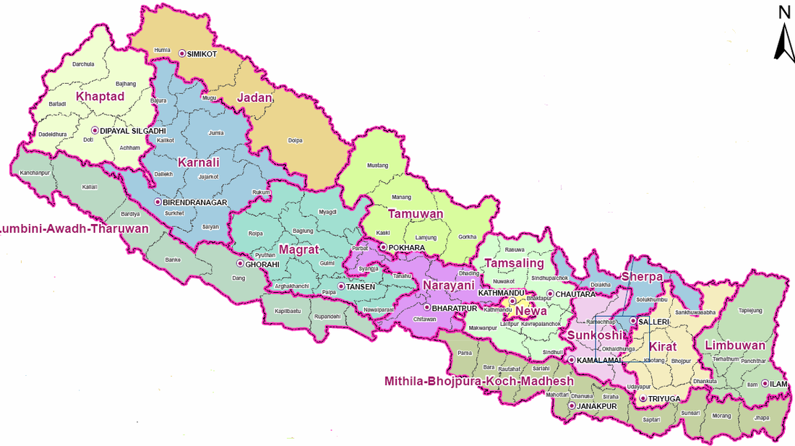
Boundaries as recommended in 2010 by the State Restructuring Committee, with states designed to provide major non-Parbatiya ethnic groups with a plurality

Slide 47
Provincial boundaries as agreed by leaders of the three main political parties in August 2015 (when the constitution was passed in September, Baglung district was all placed in Province 4 rather than the western section going to Province 5 http://admin.myrepublica.com/politics/story/26808/big-3-draw-new-7-province-map.html

Slide 48
CONCLUSIONS
Historians must be humble: `While it is reasonable to postulate a casual connection between the massive disruption of the earthquake and the eventual declaration of total war by Japan in 1941, it is more difficult to substantiate it.’ (Robinson 2016: 139-40). In the Nepalese context, we can only very tentatively suggest that Juddha’s handling of the 1934 earthquake was a factor in weakening the Rana regime’s legitimacy. We are on even weaker ground if we try to make a link between the 1988 earthquake and the collapse of the Panchayat year two years later.
After a major disaster, an `accelerated status quo’ (Pelling & Dill: 2010: 22)is as likely as a successful challenge to established power structures. In 2015, the sense of urgency produced by the earthquake appears to have allowed politicians to agree a document more conservative than both the ethnic activists and the Maoists had been calling for.

Slide 49
SOURCES FOR ILLUSTRATIONS
Kohat tehsil gate: https://www.flickr.com/photos/59036290@N07/5989995439/
Rudra and Kiran
http://historylessonsnepal.blogspot.com/2013/03/the-b-c-conundrum.html

Slide 50
WEBSITES
https://sway.soscbaha.org/
(SWAY site)
https://www.youtube.com/watch?v=B_uSwAXkerA (Red Panda video)
https://linguae.weebly.com/nepali.html
(proposed federal structures)
https://www.thelongestwayhome.com/travel-guides/nepal/temples-buildings-destroyed-nepal-earthquake-2015.html
https://www.intechopen.com/online-first/impacts-of-the-2015-gorkha-earthquake-lessons-learnt-from-nepal (figures to December 2018)

Slide 51
REFERENCES
Fujiwara, T, T.Sato, T.Kubo, H & ,O,Murakami 1989 Reconnaissance Report on the 21 August 1988 Earthquake in the Nepal-India Border Region (Research Report on Natural Disasters, Supported by the Japanese Ministry of Education, Science and Culture (Grant No.63115047)) https://gemecd.org/sites/gemecd/files/JSCE%20ReconReport_1988%20Nepal-India%20Region_pp%2036-93.pdf (accessed 23/12/18)
Gautam, Bhaskar& Yogesh Raj. 2015.Courage in chaos: early rescue and relief after the April earthquake. Kathmandu: Martin Chautari.
Hoftun, Martin, William Raeper and John Whelpton. 1999. People, Politics and Ideology: Democracy and Social Change in Nepal, Kathmandu: Mandala.
Palmer, James 2012. The Death of Mao: The Tangshan Earthquake and the Birth of the New China. London: Faber & Faber
Pelling, Mark & Kathleen Dill 2010. `Disaster politics: tipping points for change in the adaptation of socio-political regimes.’ Progress in Human Geography 34(1): 21-37.
Pradhan, Kumar L. 2012. Thapa Politics in Nepal: with special reference to Bhimsen Thapa 1806 to 1839. New Delhi: Concept Publishing
Rana, Brahma S.J.B. 2013. The Great Earthquake in Nepal (1934 A.D.) [translated by Kesar Lall] Kathmandu: Ratna Pustak Bhandar. [First published in Nepali as Nepalkomahabhukampa (1990 sal). Kathmandu: Babarmahal, 1991 V.S. [1934-5]]
Rana, Purushotham S.J.B. Shri Teenharuko Vrittanta [Account of the Rana Maharajas]. Kathmandu:
Robinson, Andrew. Edward 2016. Earth-shattering Events: Earthquakes, Nations and Civilization. London: Thames & Hudson.
Simpson, Edward 2013. The Political Biography of an Earthquake: Aftermath and Amnesia in Gujarat, India. London: Hurst & Co.
Subedi, Shiva and Meen Bahadur Poudyal Chhetri 2019.
Thapa, Niranjan, 1989 [2045 V.S.]. Bhadau Panchko Bhukampa 2045 [Earthquake of 21 August 1988]. Kathmandu: Niranjan Thapa.
Uprety, Prem R. 1984. Nepal – a Small Nation in the Vortex of International Conflicts. Kathmandu: Pugo Mi.
Whelpton, John 2005. A History of Nepal, Cambridge: Cambridge University Press, 2005
World Bank 1997. MUNICIPAL DEVELOPMENT AND EARTHQUAKE EMERGENCY HOUSING RECONSTRUCTION PROJECT (CREDIT 1988-NEP). Project Completion Report (Nepal)

